Slide 1
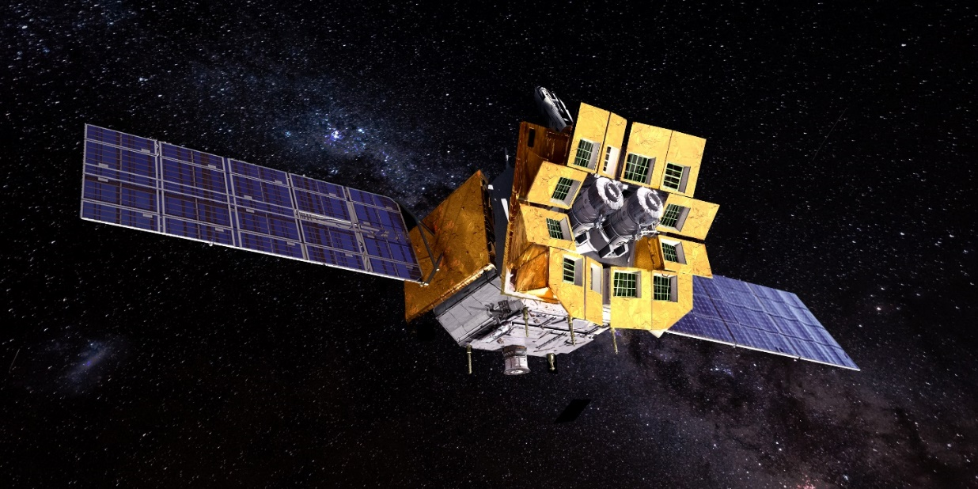
FXT performance in orbit comparison with ground
Xiaofan Zhao, on behalf of FXT team
2024.5.13

Slide 2
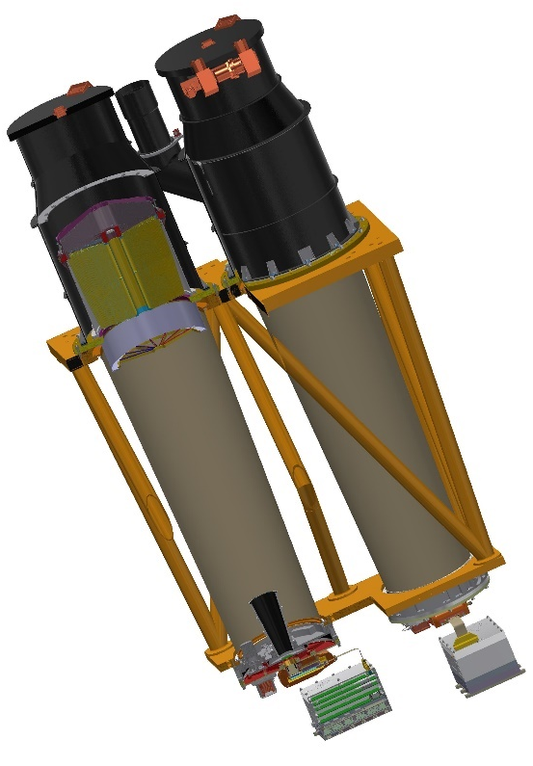
Introduction
FXT includes 2 units of completely independent optical system and detector system (FXT-A and FXT-B).
mirror assembly is Wolter-I type imaging system with a focal length of 1.6m.
focal plane camera is composed of imaging PNCCD, readout electronics and filter wheel.
The work modes of PNCCD include full frame mode (FF, 50ms), patial window mode (PW, 2.2ms) and timing mode (TM).

Slide 3
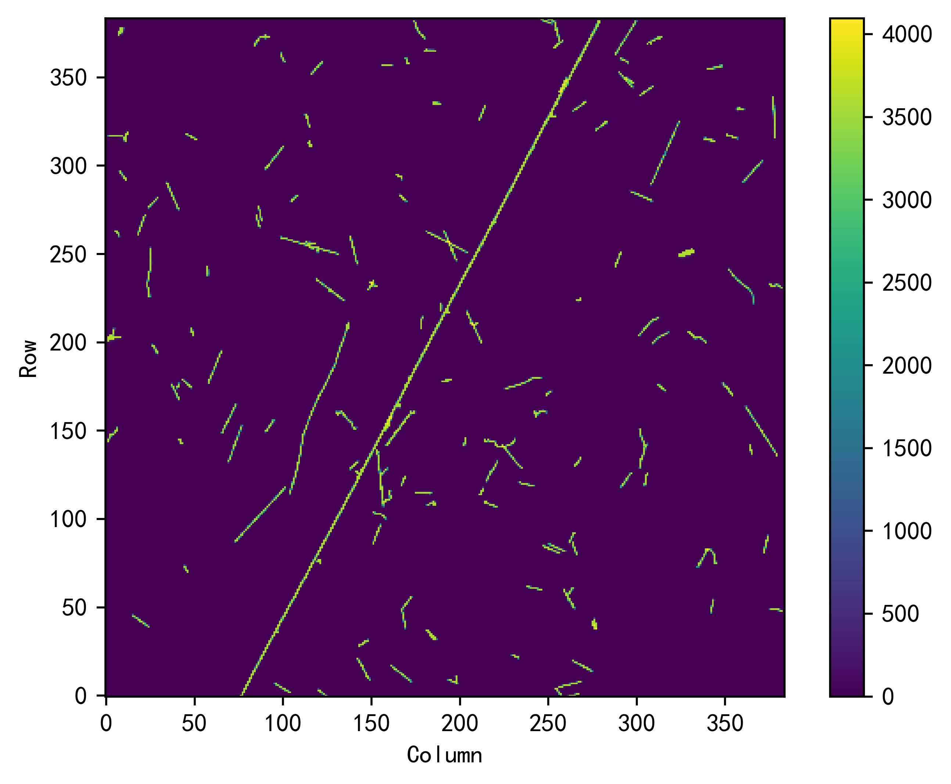
Preliminary results of PNCCD
FXT-A and FXT-B start up at the end of January and early February respectively. At this point, the turning cover is still closed.
During several days of background observations, variety of cosmic radiation particles hit the cameras, which in orbit amount to about 6 per second.
stack of numerous CCD raw frames

Slide 4
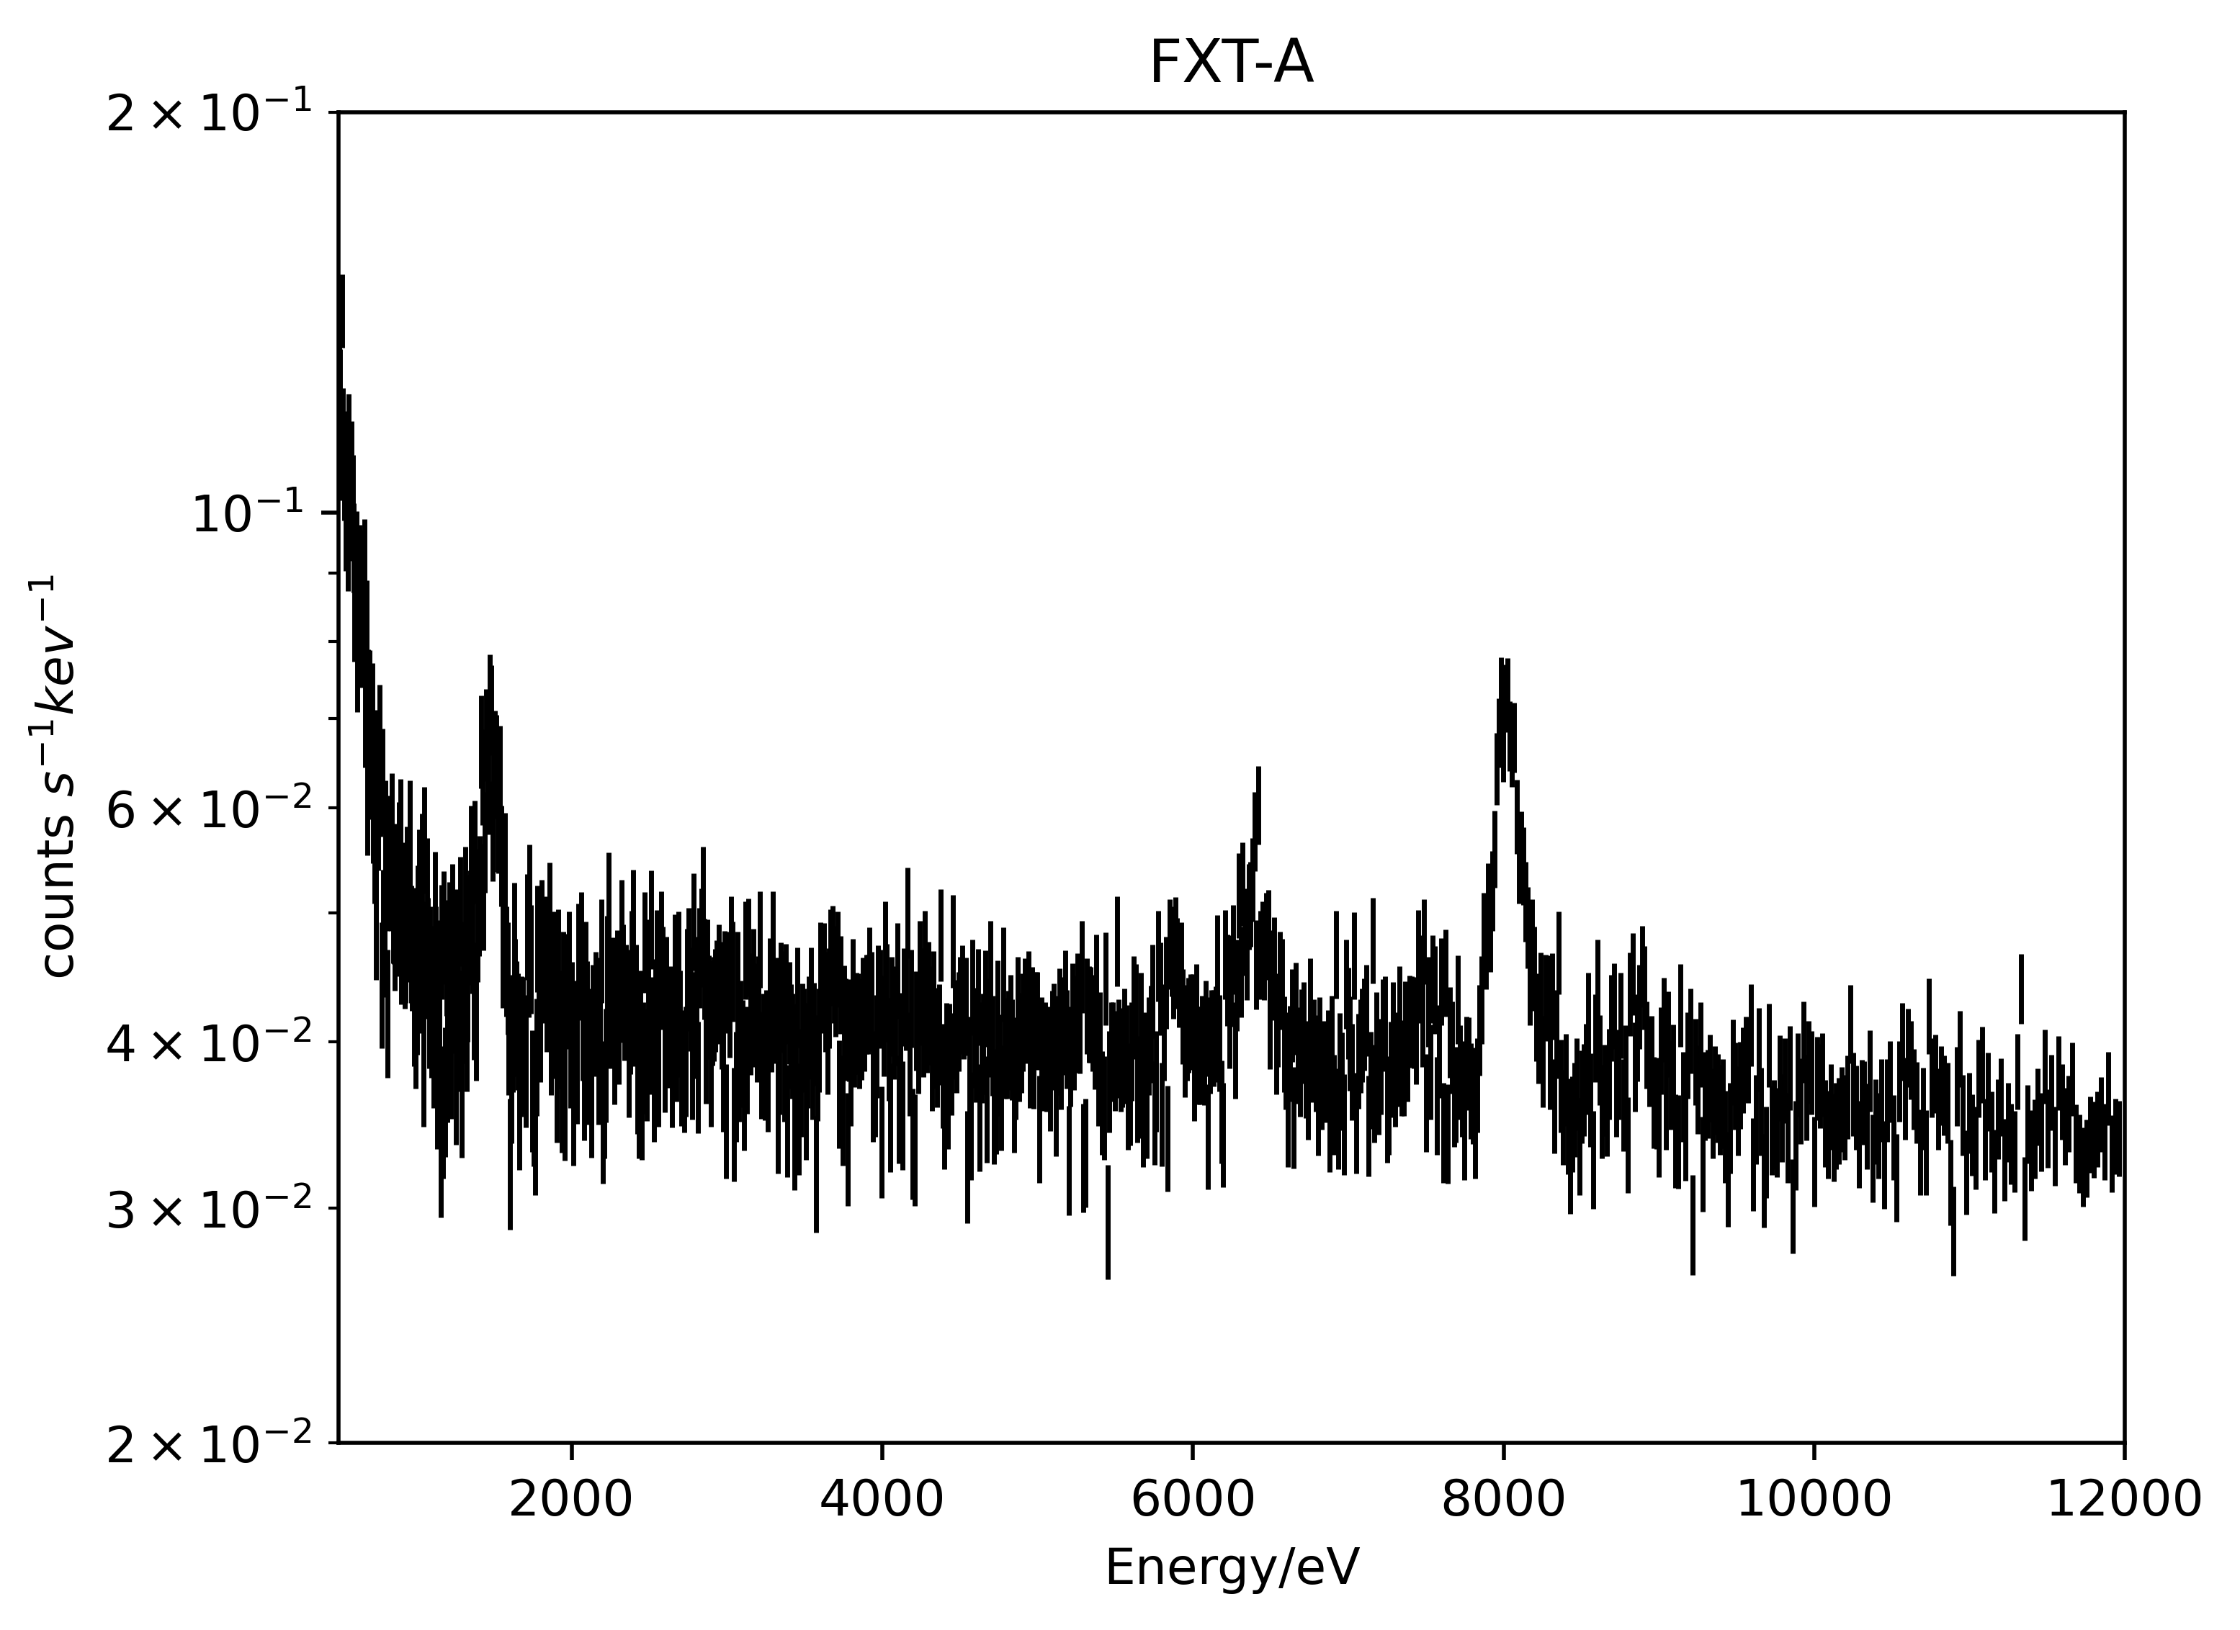
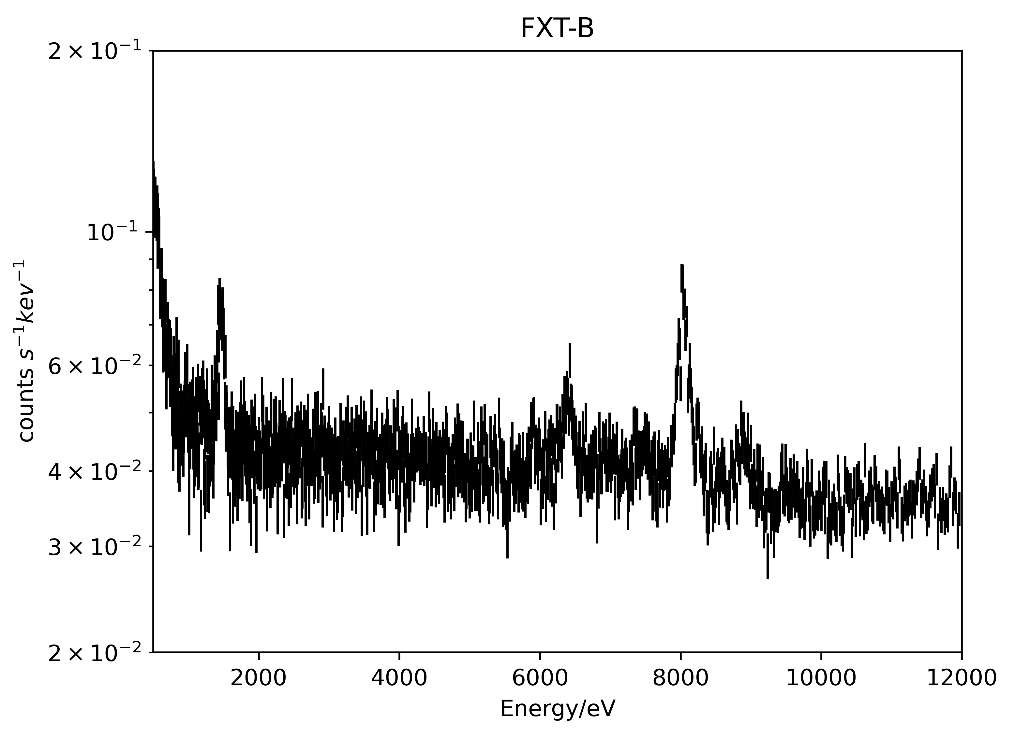
Preliminary results of PNCCD
Here is the particle background spectral.
Net count rate of FXT-A background in the energy range of 0.5-10keV is 0.41, and that of FXT-B is 0.42.
More detailed results can be found in Juan Zhang’s report.
Cu-K
Al-K
Al-K
Fe-K
Cu-K
Fe-K

Slide 5
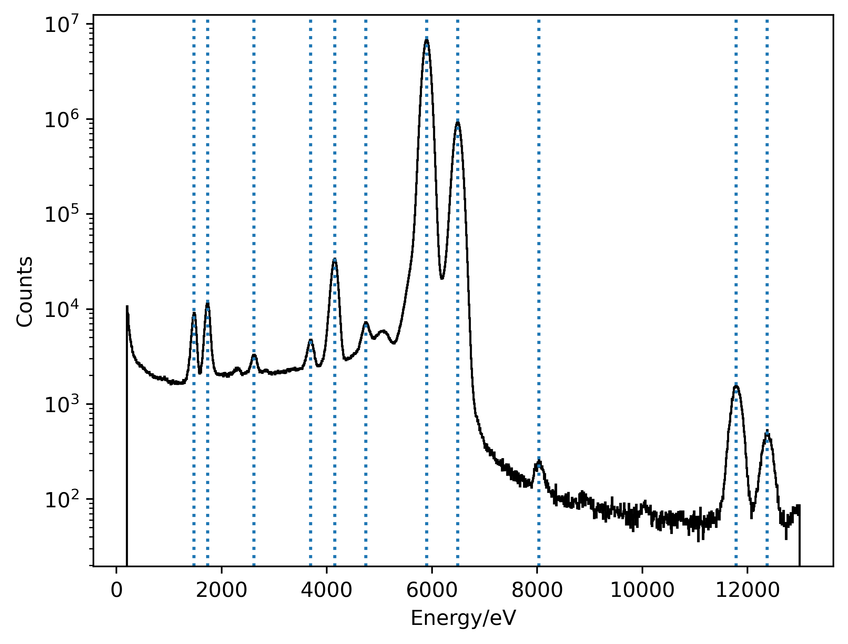
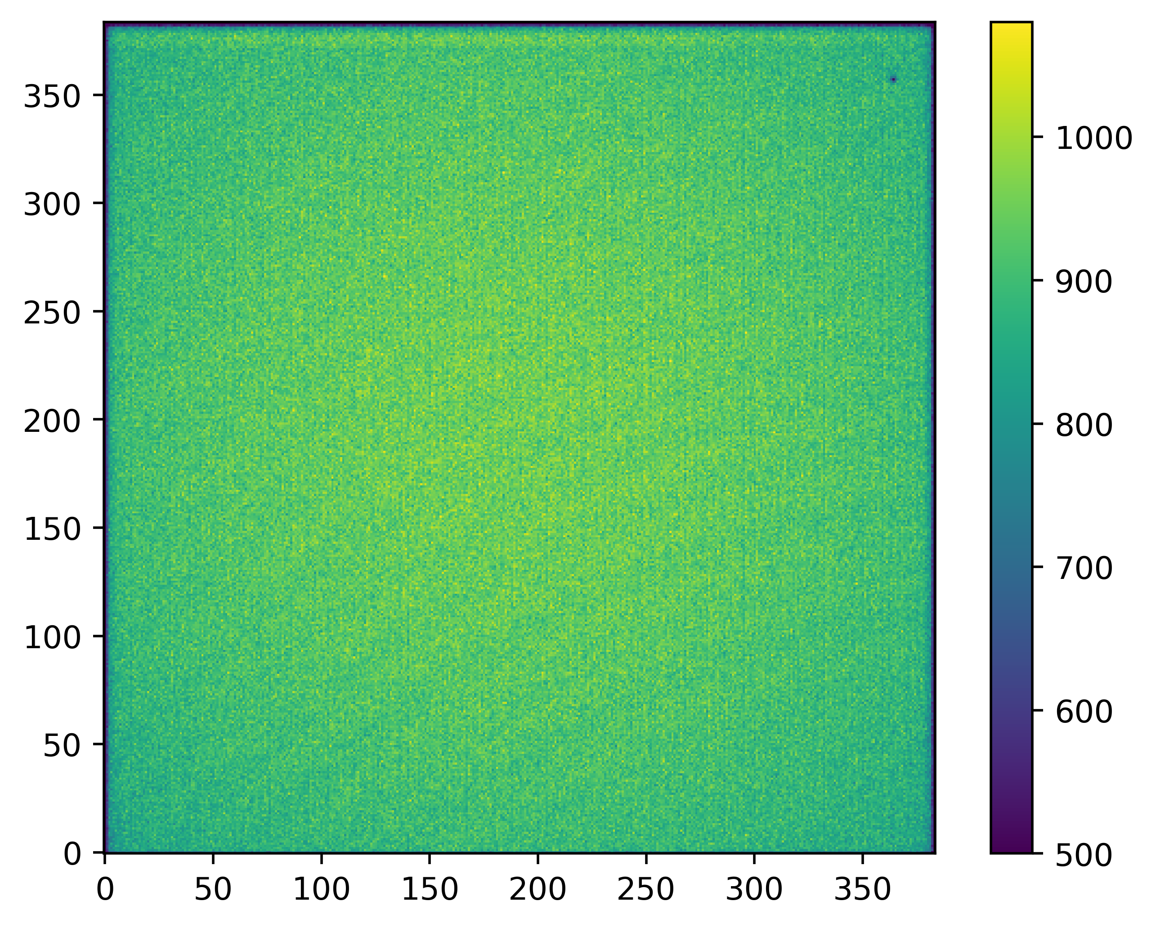
Preliminary results of PNCCD
FXT-A and FXT-B were calibrated using the radioation source Fe55 in orbit.
the following figures are spectral and image of radioation source.
spectrum of radioation source
image of radioation source

Slide 6
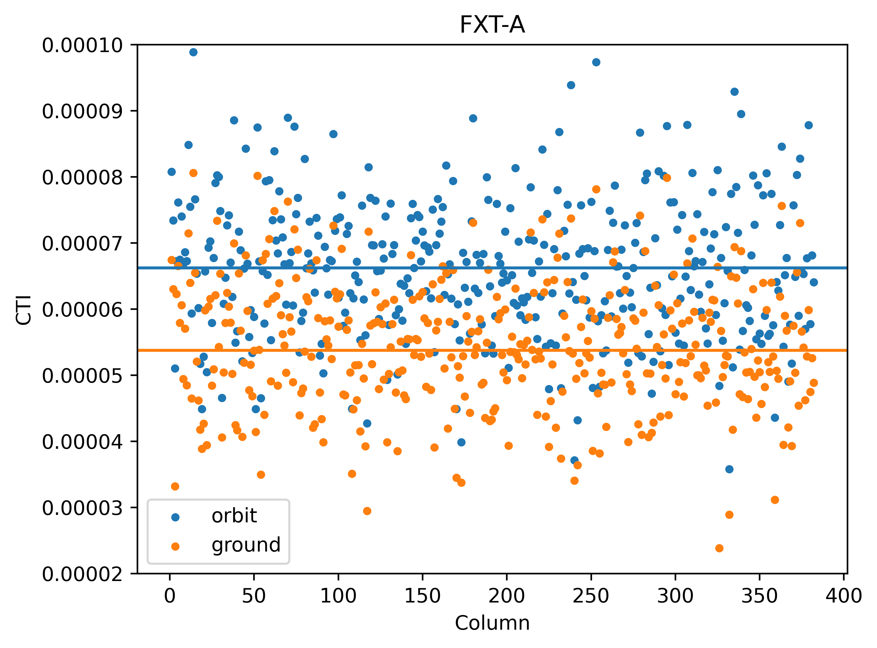
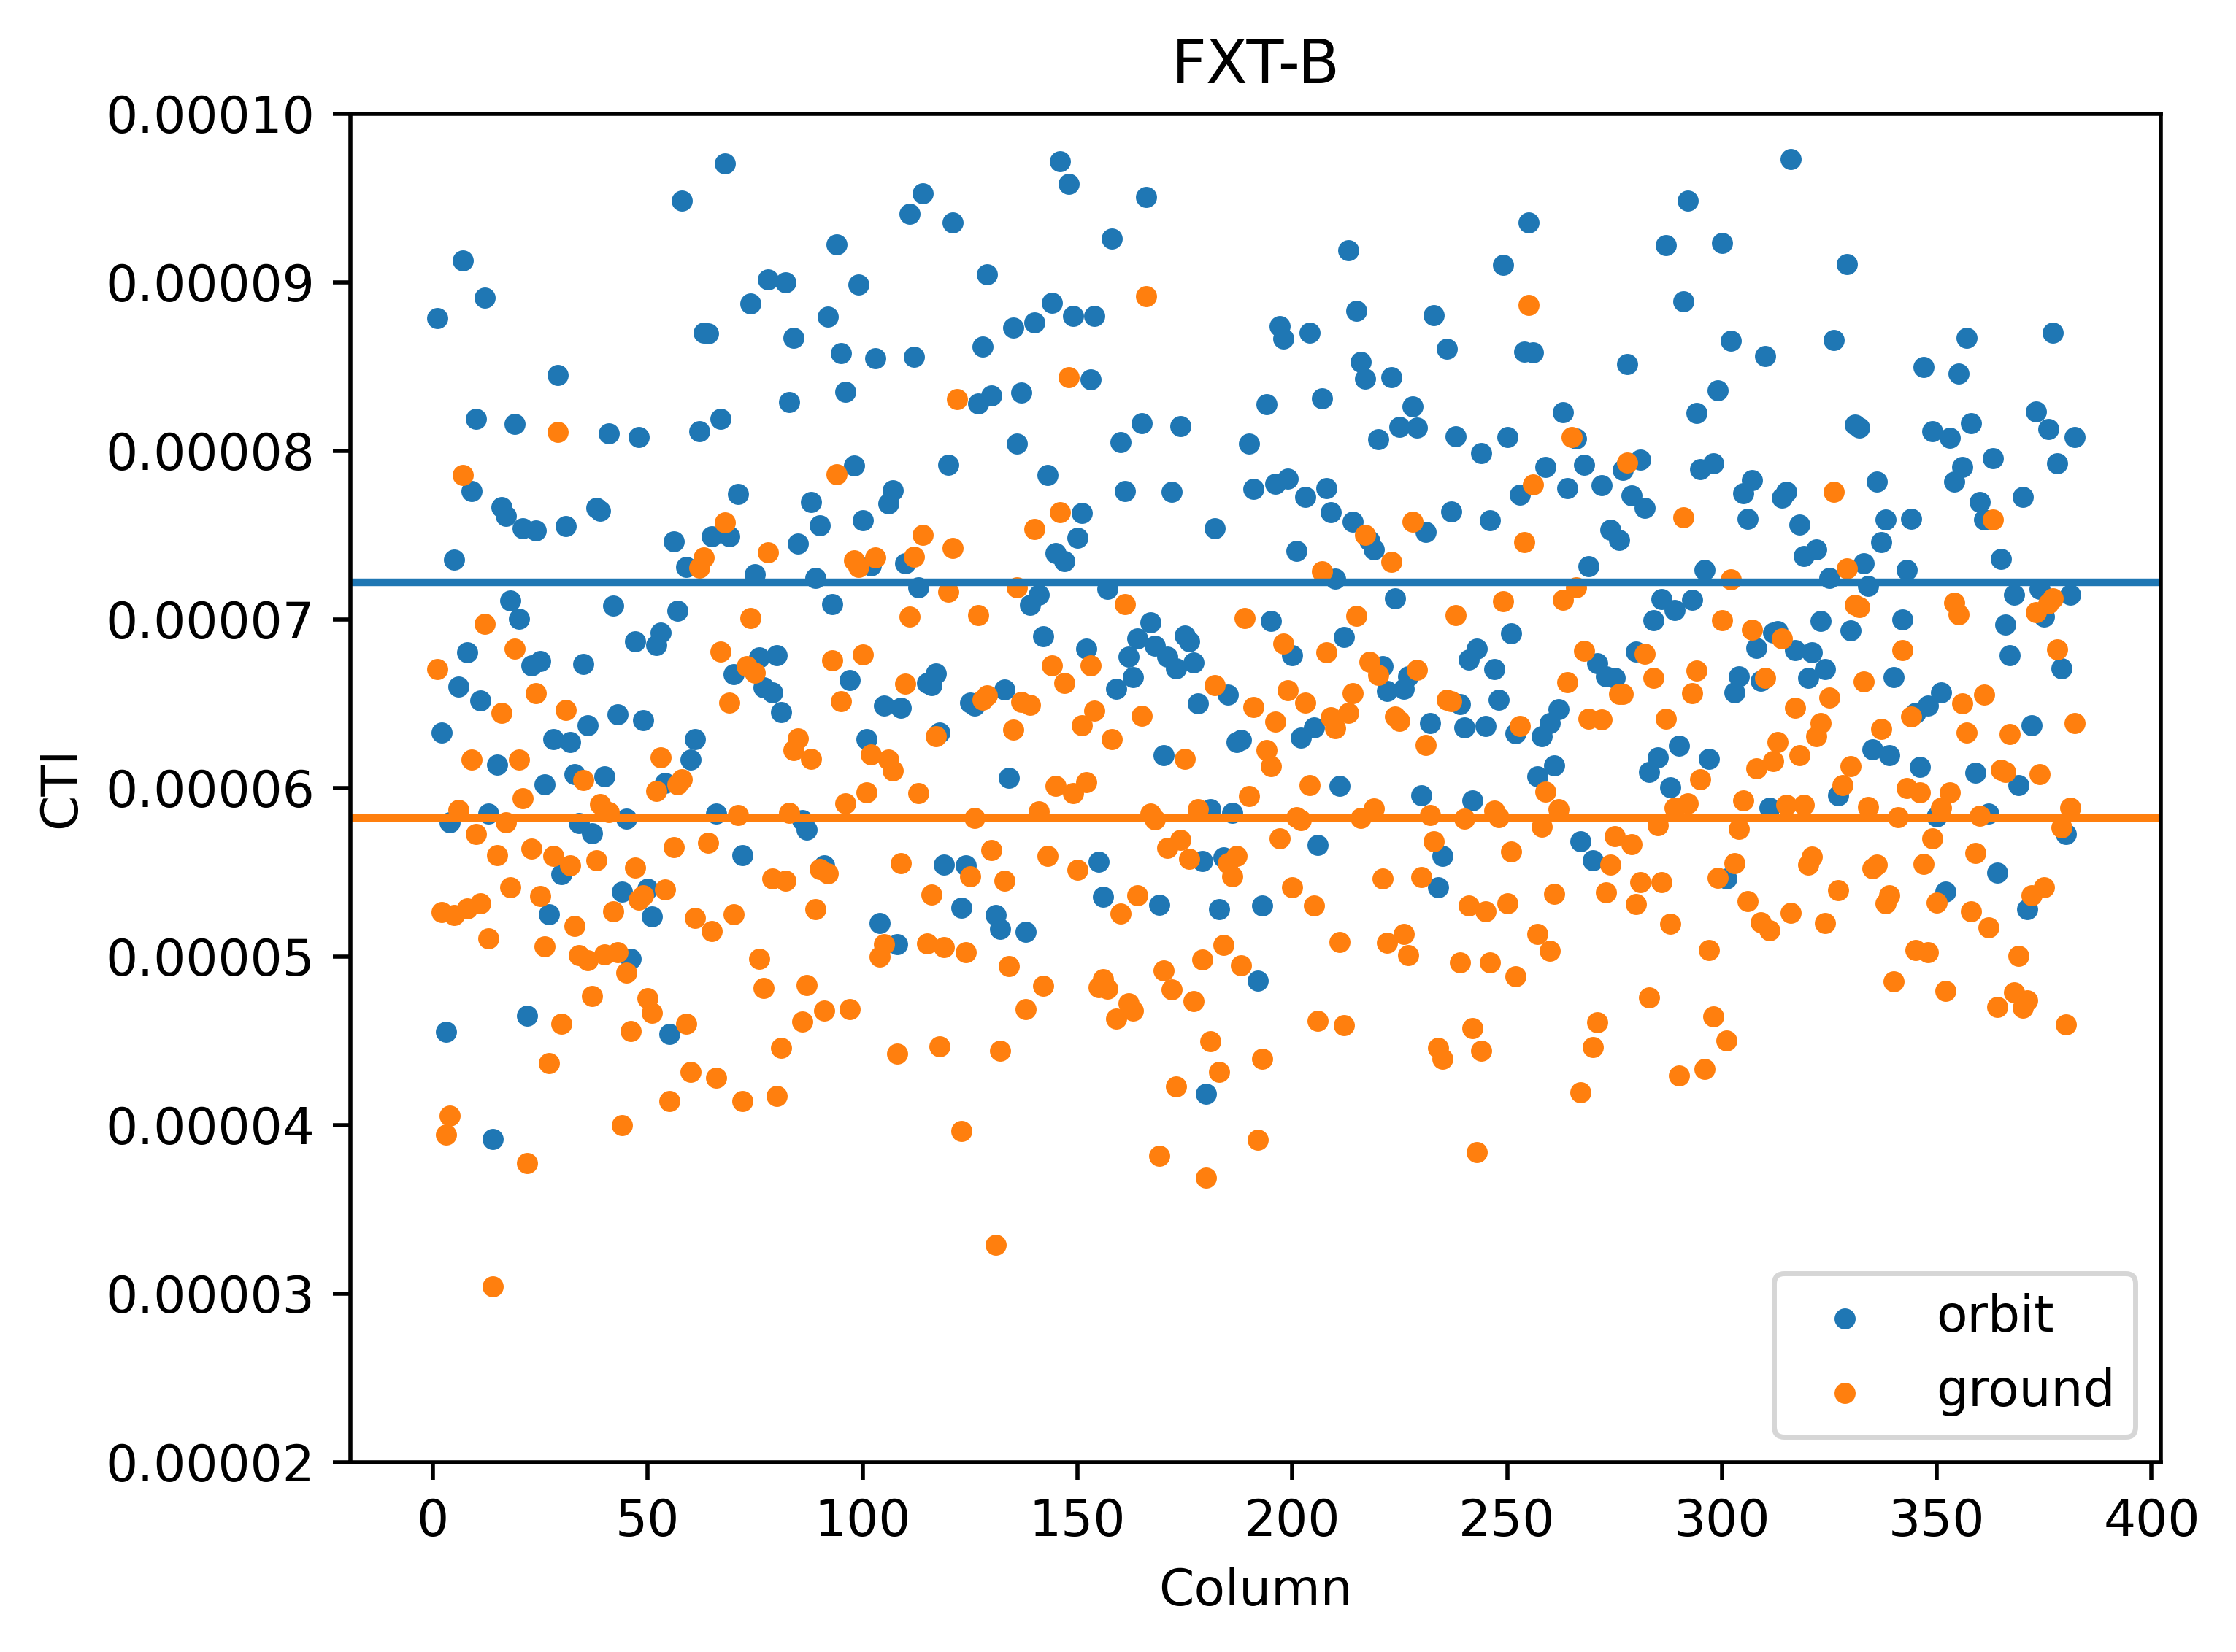
Preliminary results of PNCCD
compared to ground, the readout noise of FXT-A and FXT-B are almost the same, which is about 3 e⁻.
the charge transfer inefficiency (CTI) is slightly higher.
FXT-A is from 5.3e-5 to 6.6e-5
FXT-B is from 5.8e-5 to 7.2e-5

Slide 7
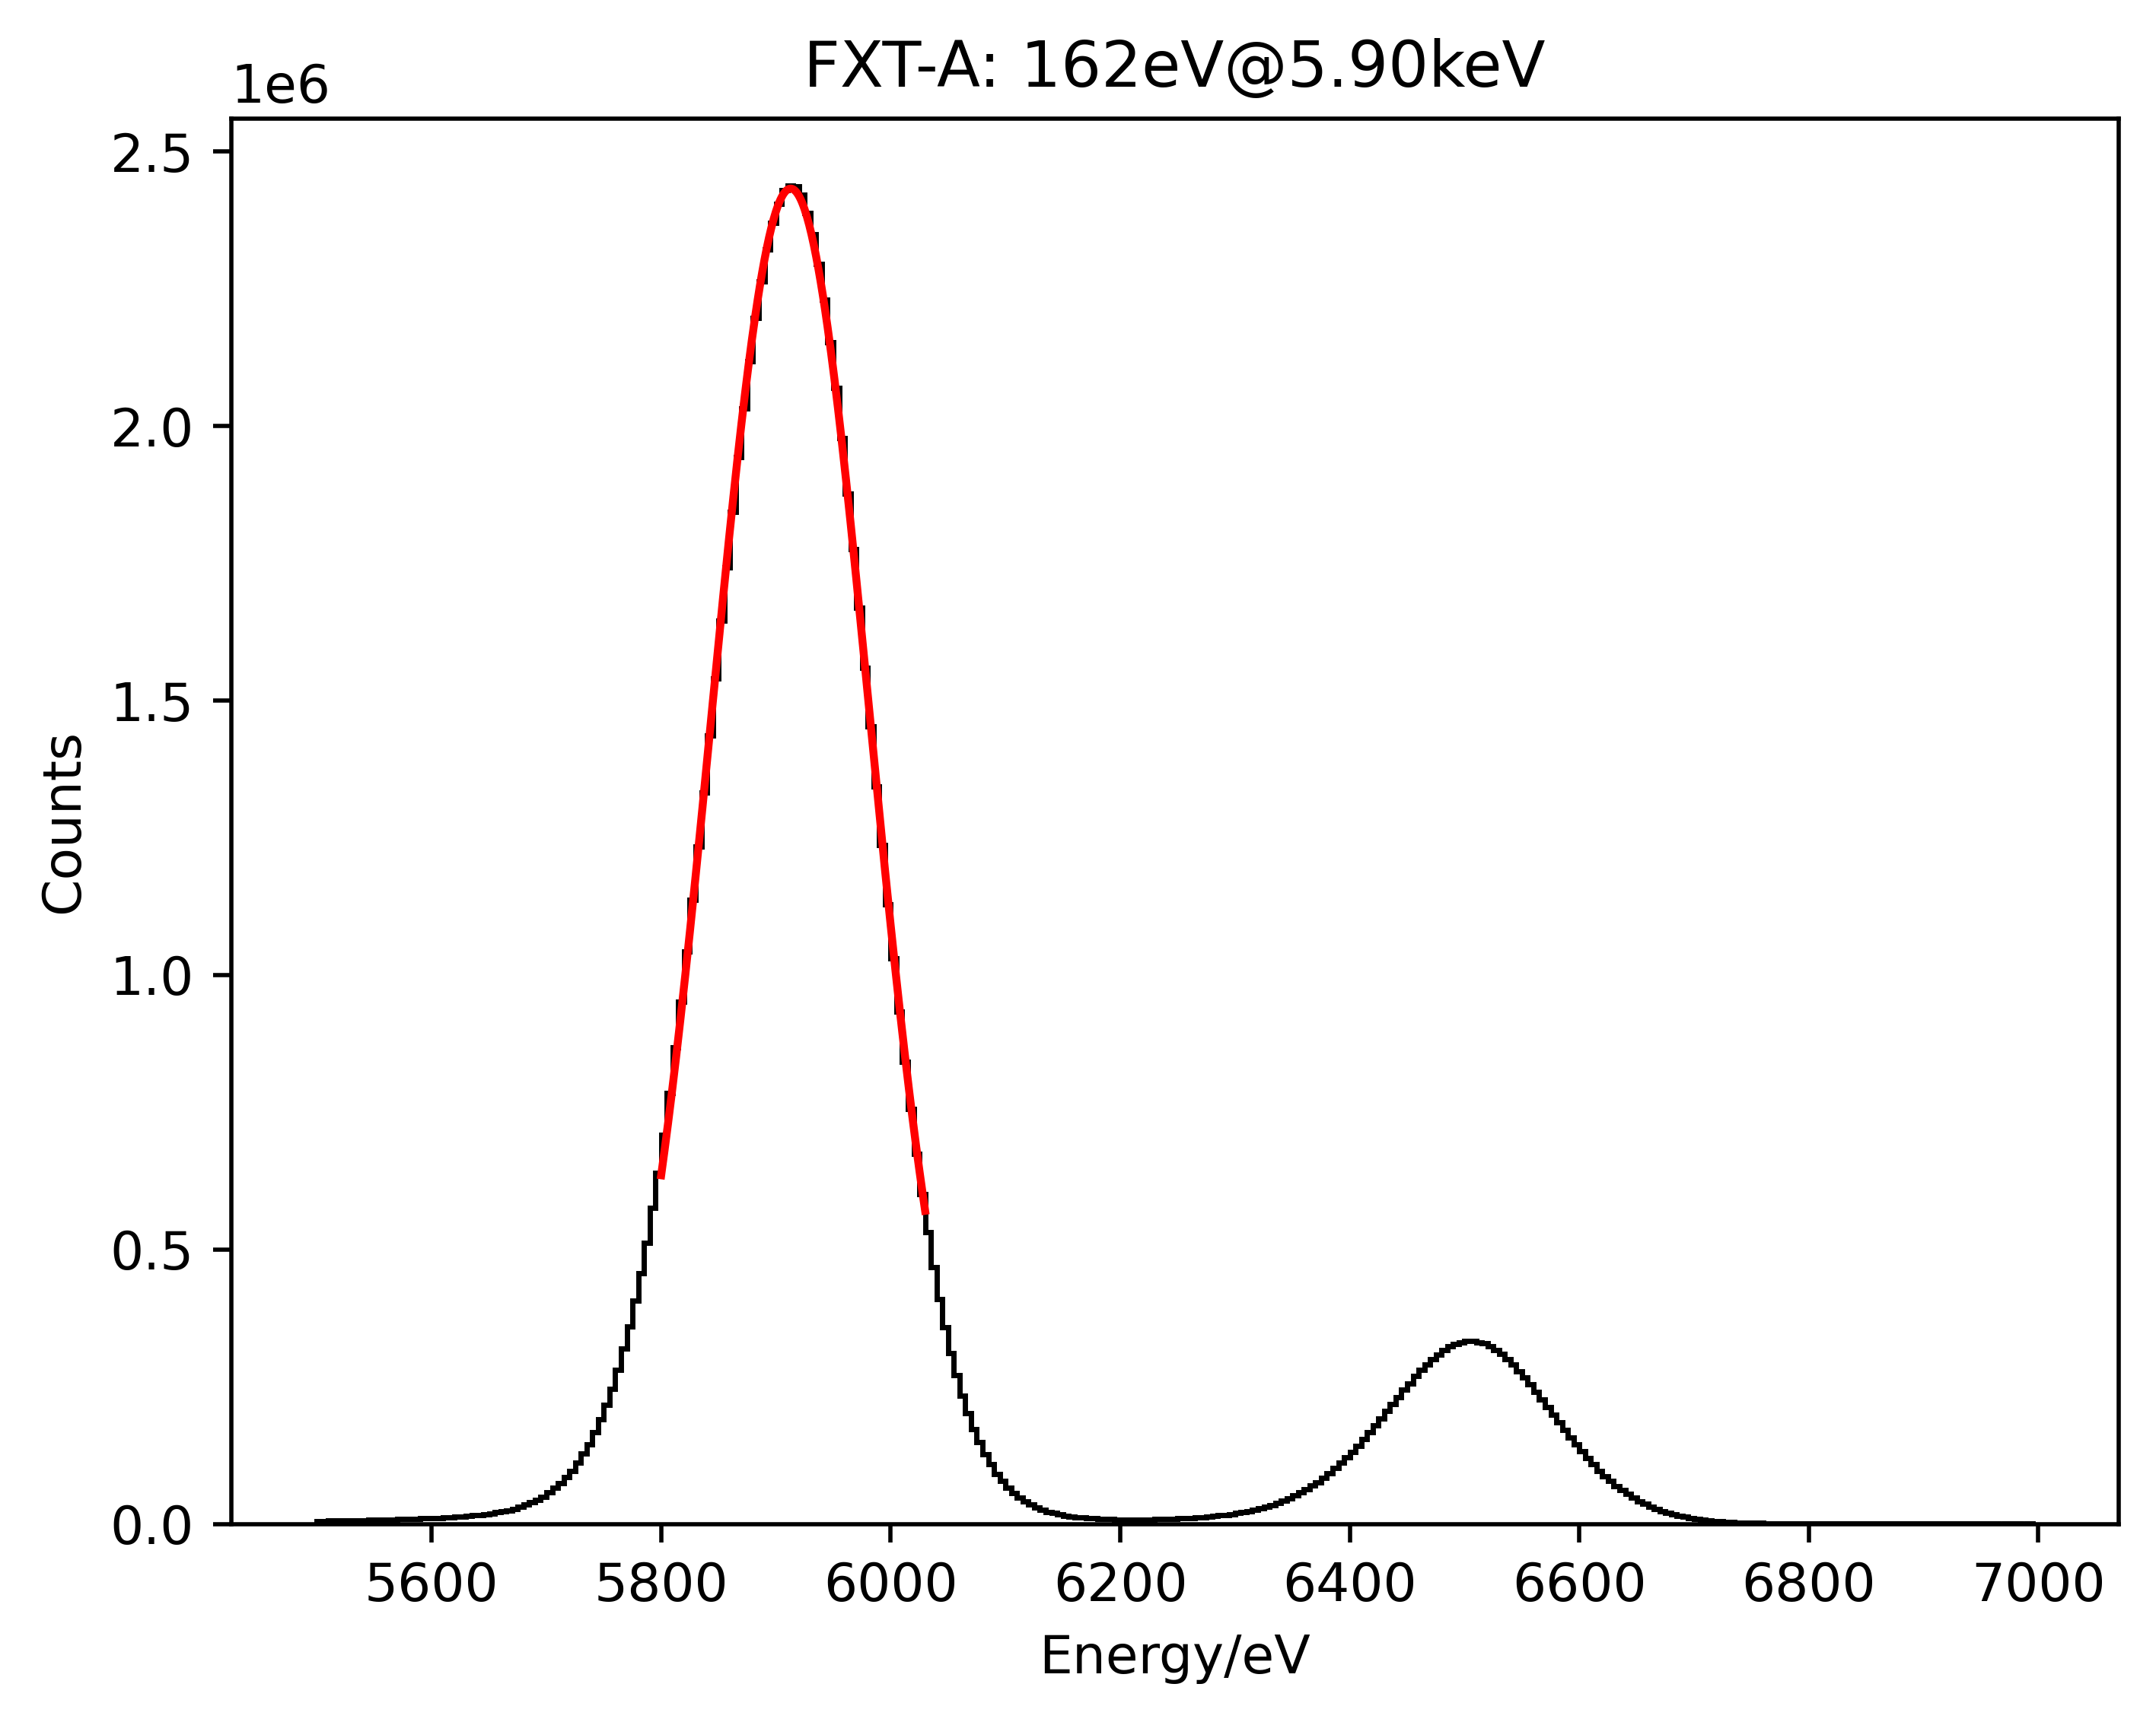
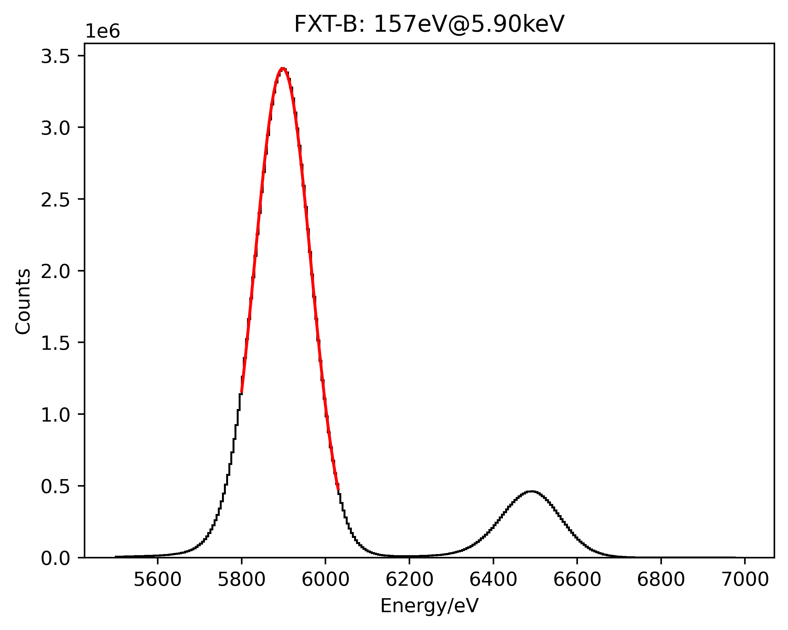
Preliminary results of PNCCD
Due to a slight increase in CTI, the energy resolution has also decreased slightly.
 | FXT-A (ground) | FXT-A (orbit) | FXT-B (ground) | FXT-B (orbit)
Al-K(1.49keV) | 96eV | 98eV | 94eV | 95eV
Fe-K(5.90keV) | 157eV | 162eV | 154eV | 157eV

Slide 8
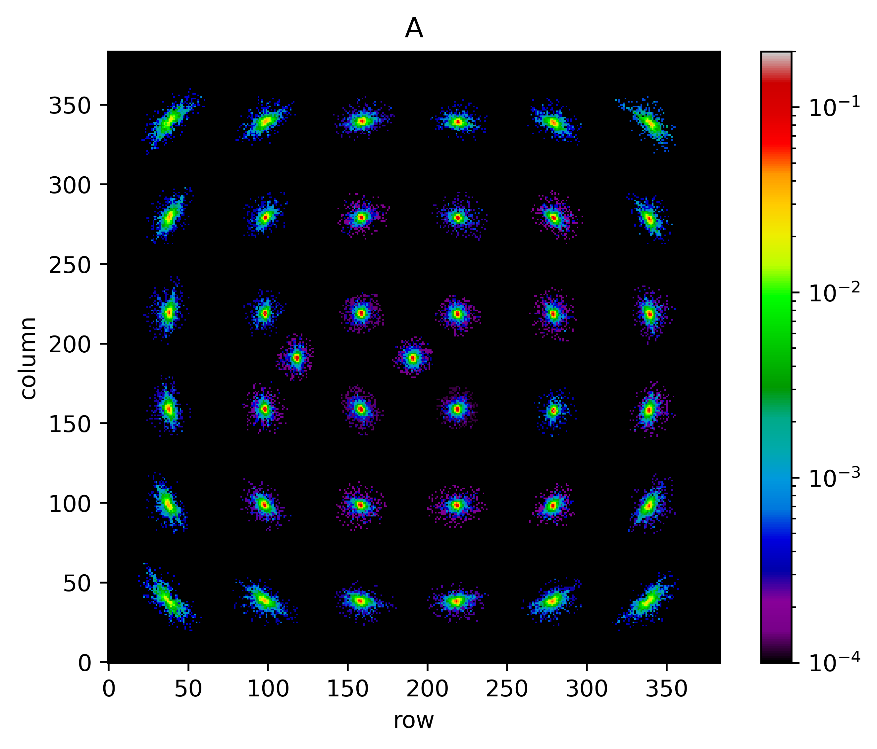
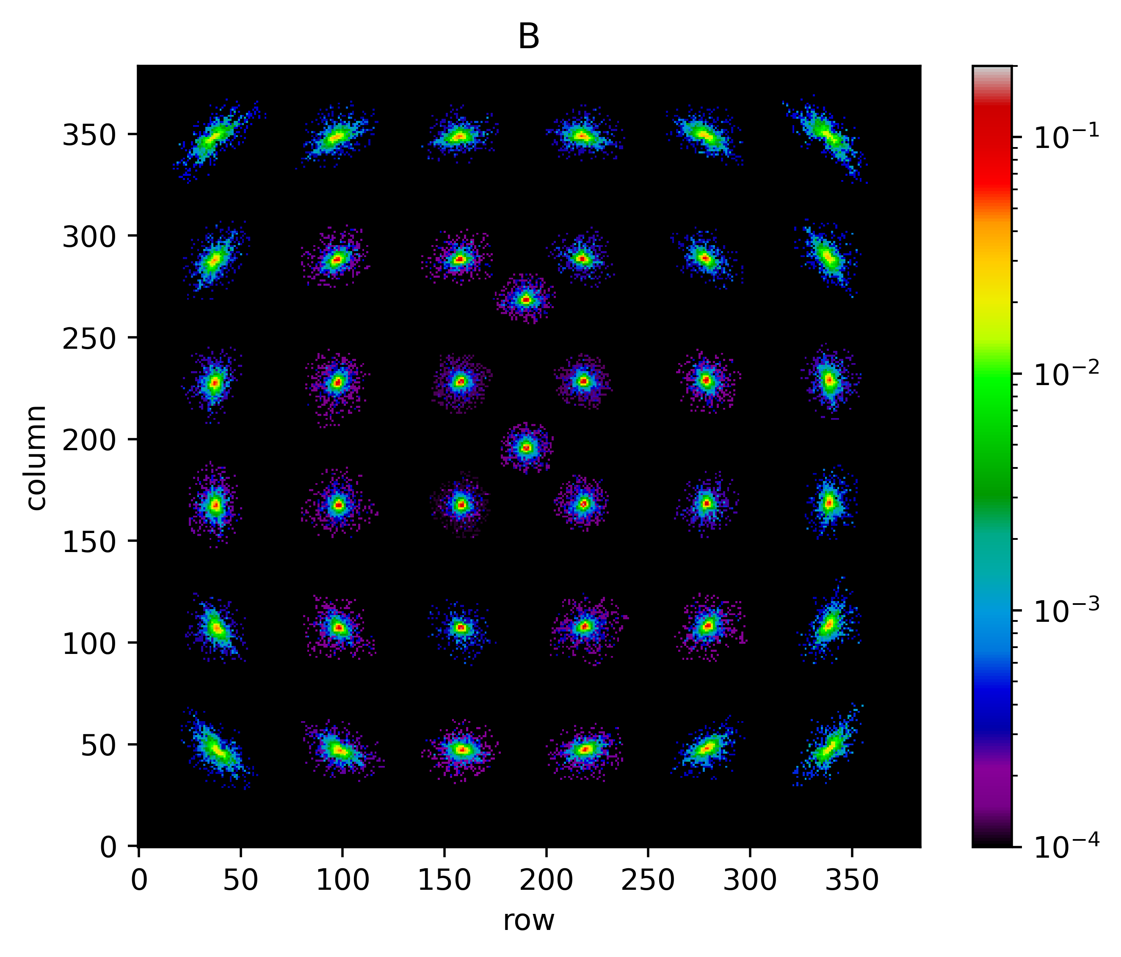
Preliminary results of mirror assembly
In order to obtain the direction of optical axis, an axis scanning method is used in orbit.
FXT conducts mulitple observations of the source 3C273 in different directions.
The PSF image at detector coordinates is as follows. Left is FXT-A, right is FXT-B.

Slide 9
Preliminary results of mirror assembly
The total observation time lasts about 2.5 days.A grid of 6×6 was used for 36 observations. An observation was made on axis.
In addition, 6 observations were made at different time in a fixed direction to monitor changes in flux of source 3C273.

Slide 10
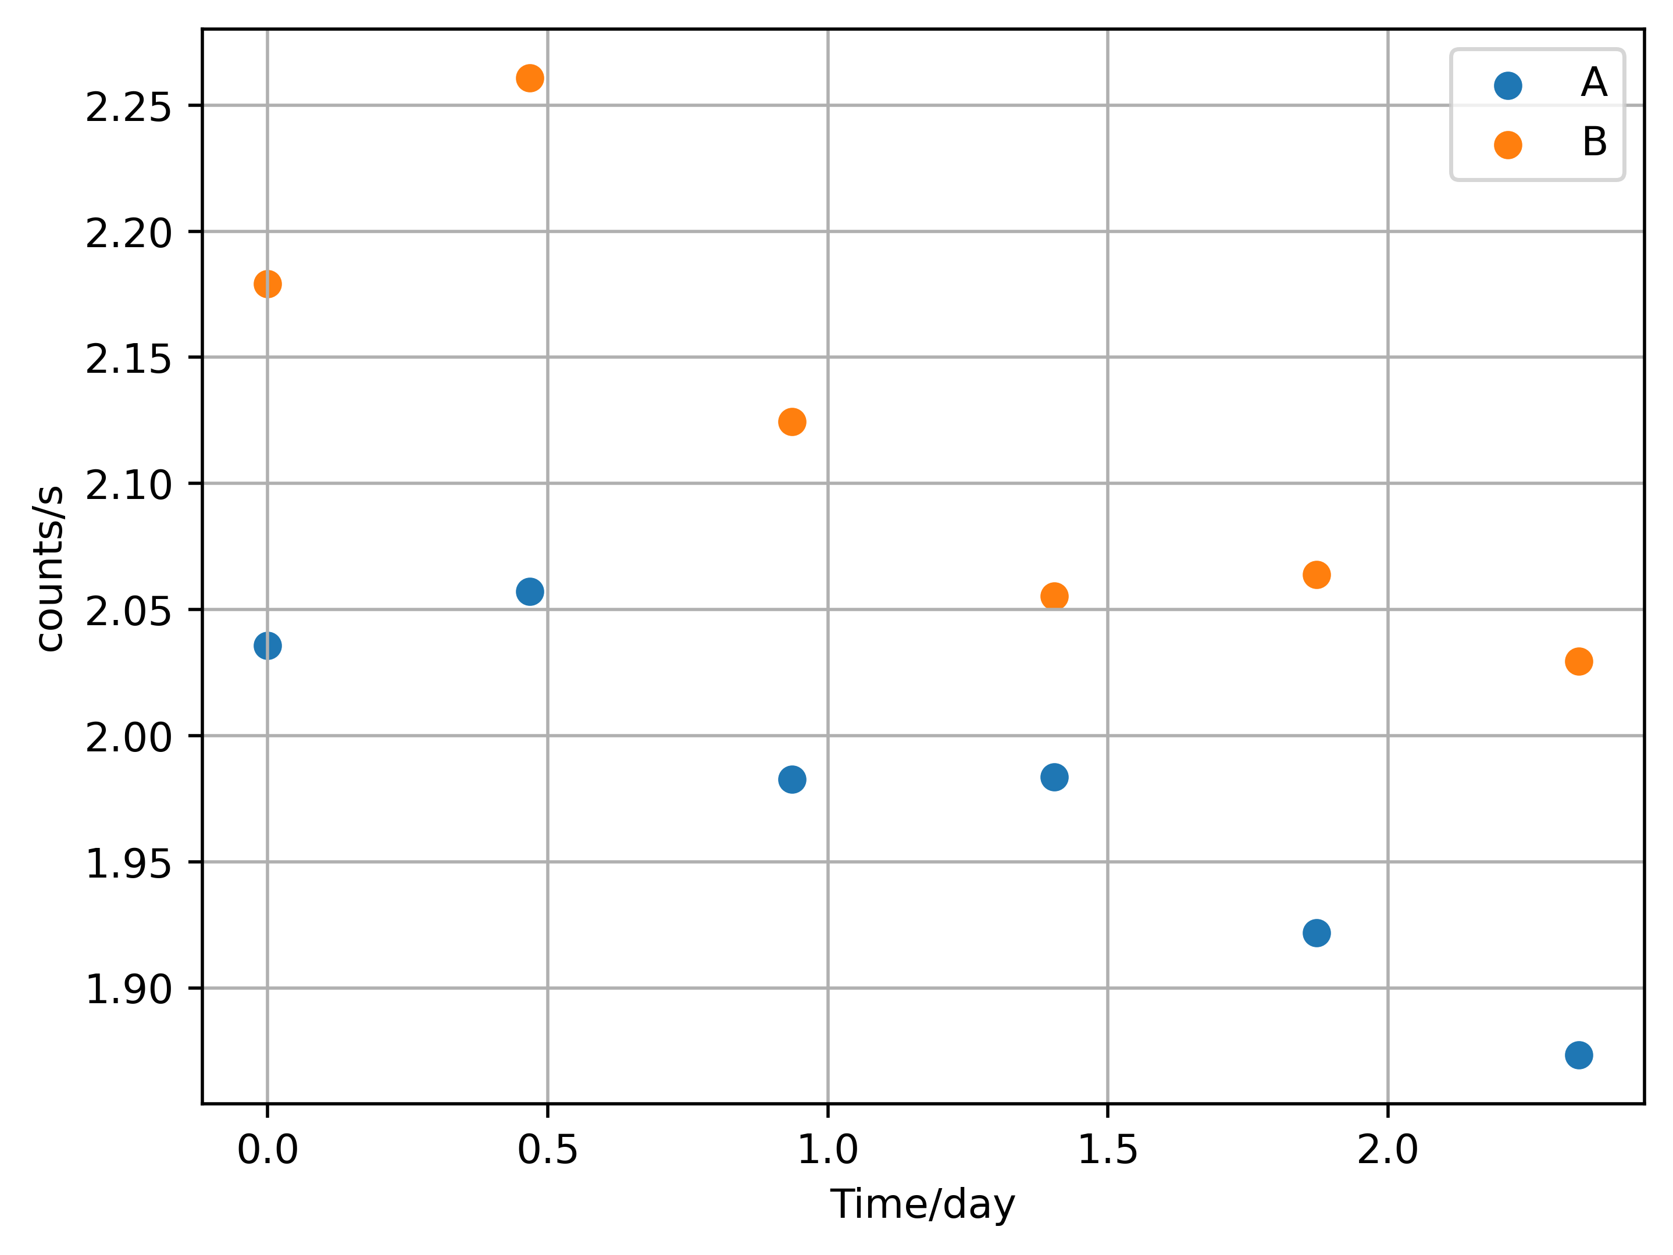
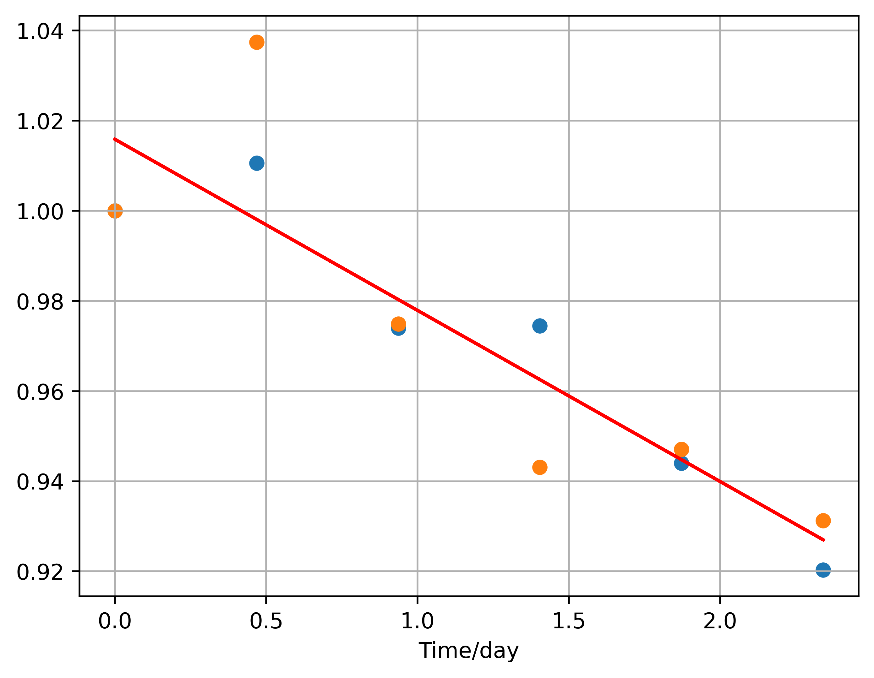
Preliminary results of mirror assembly
The flux detected by FXT-A and FXT-B has decreased by about 10%.
using the first monitoring as flux standard, a linear fit to estimate flux changes of 3C273.
adjust the flux for all observation with flux changes.

Slide 11
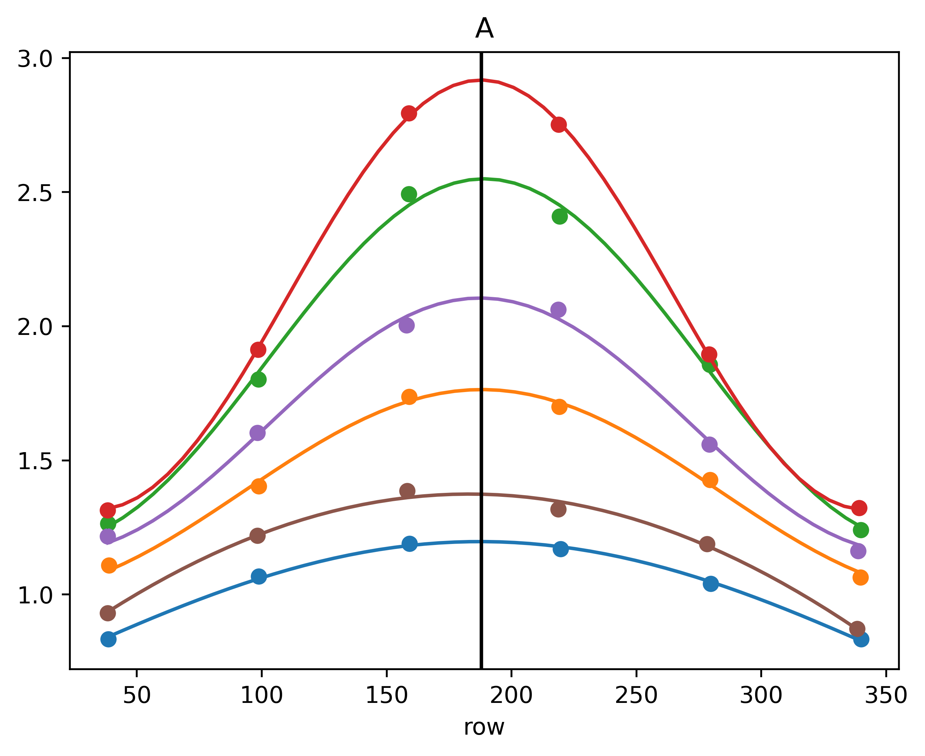
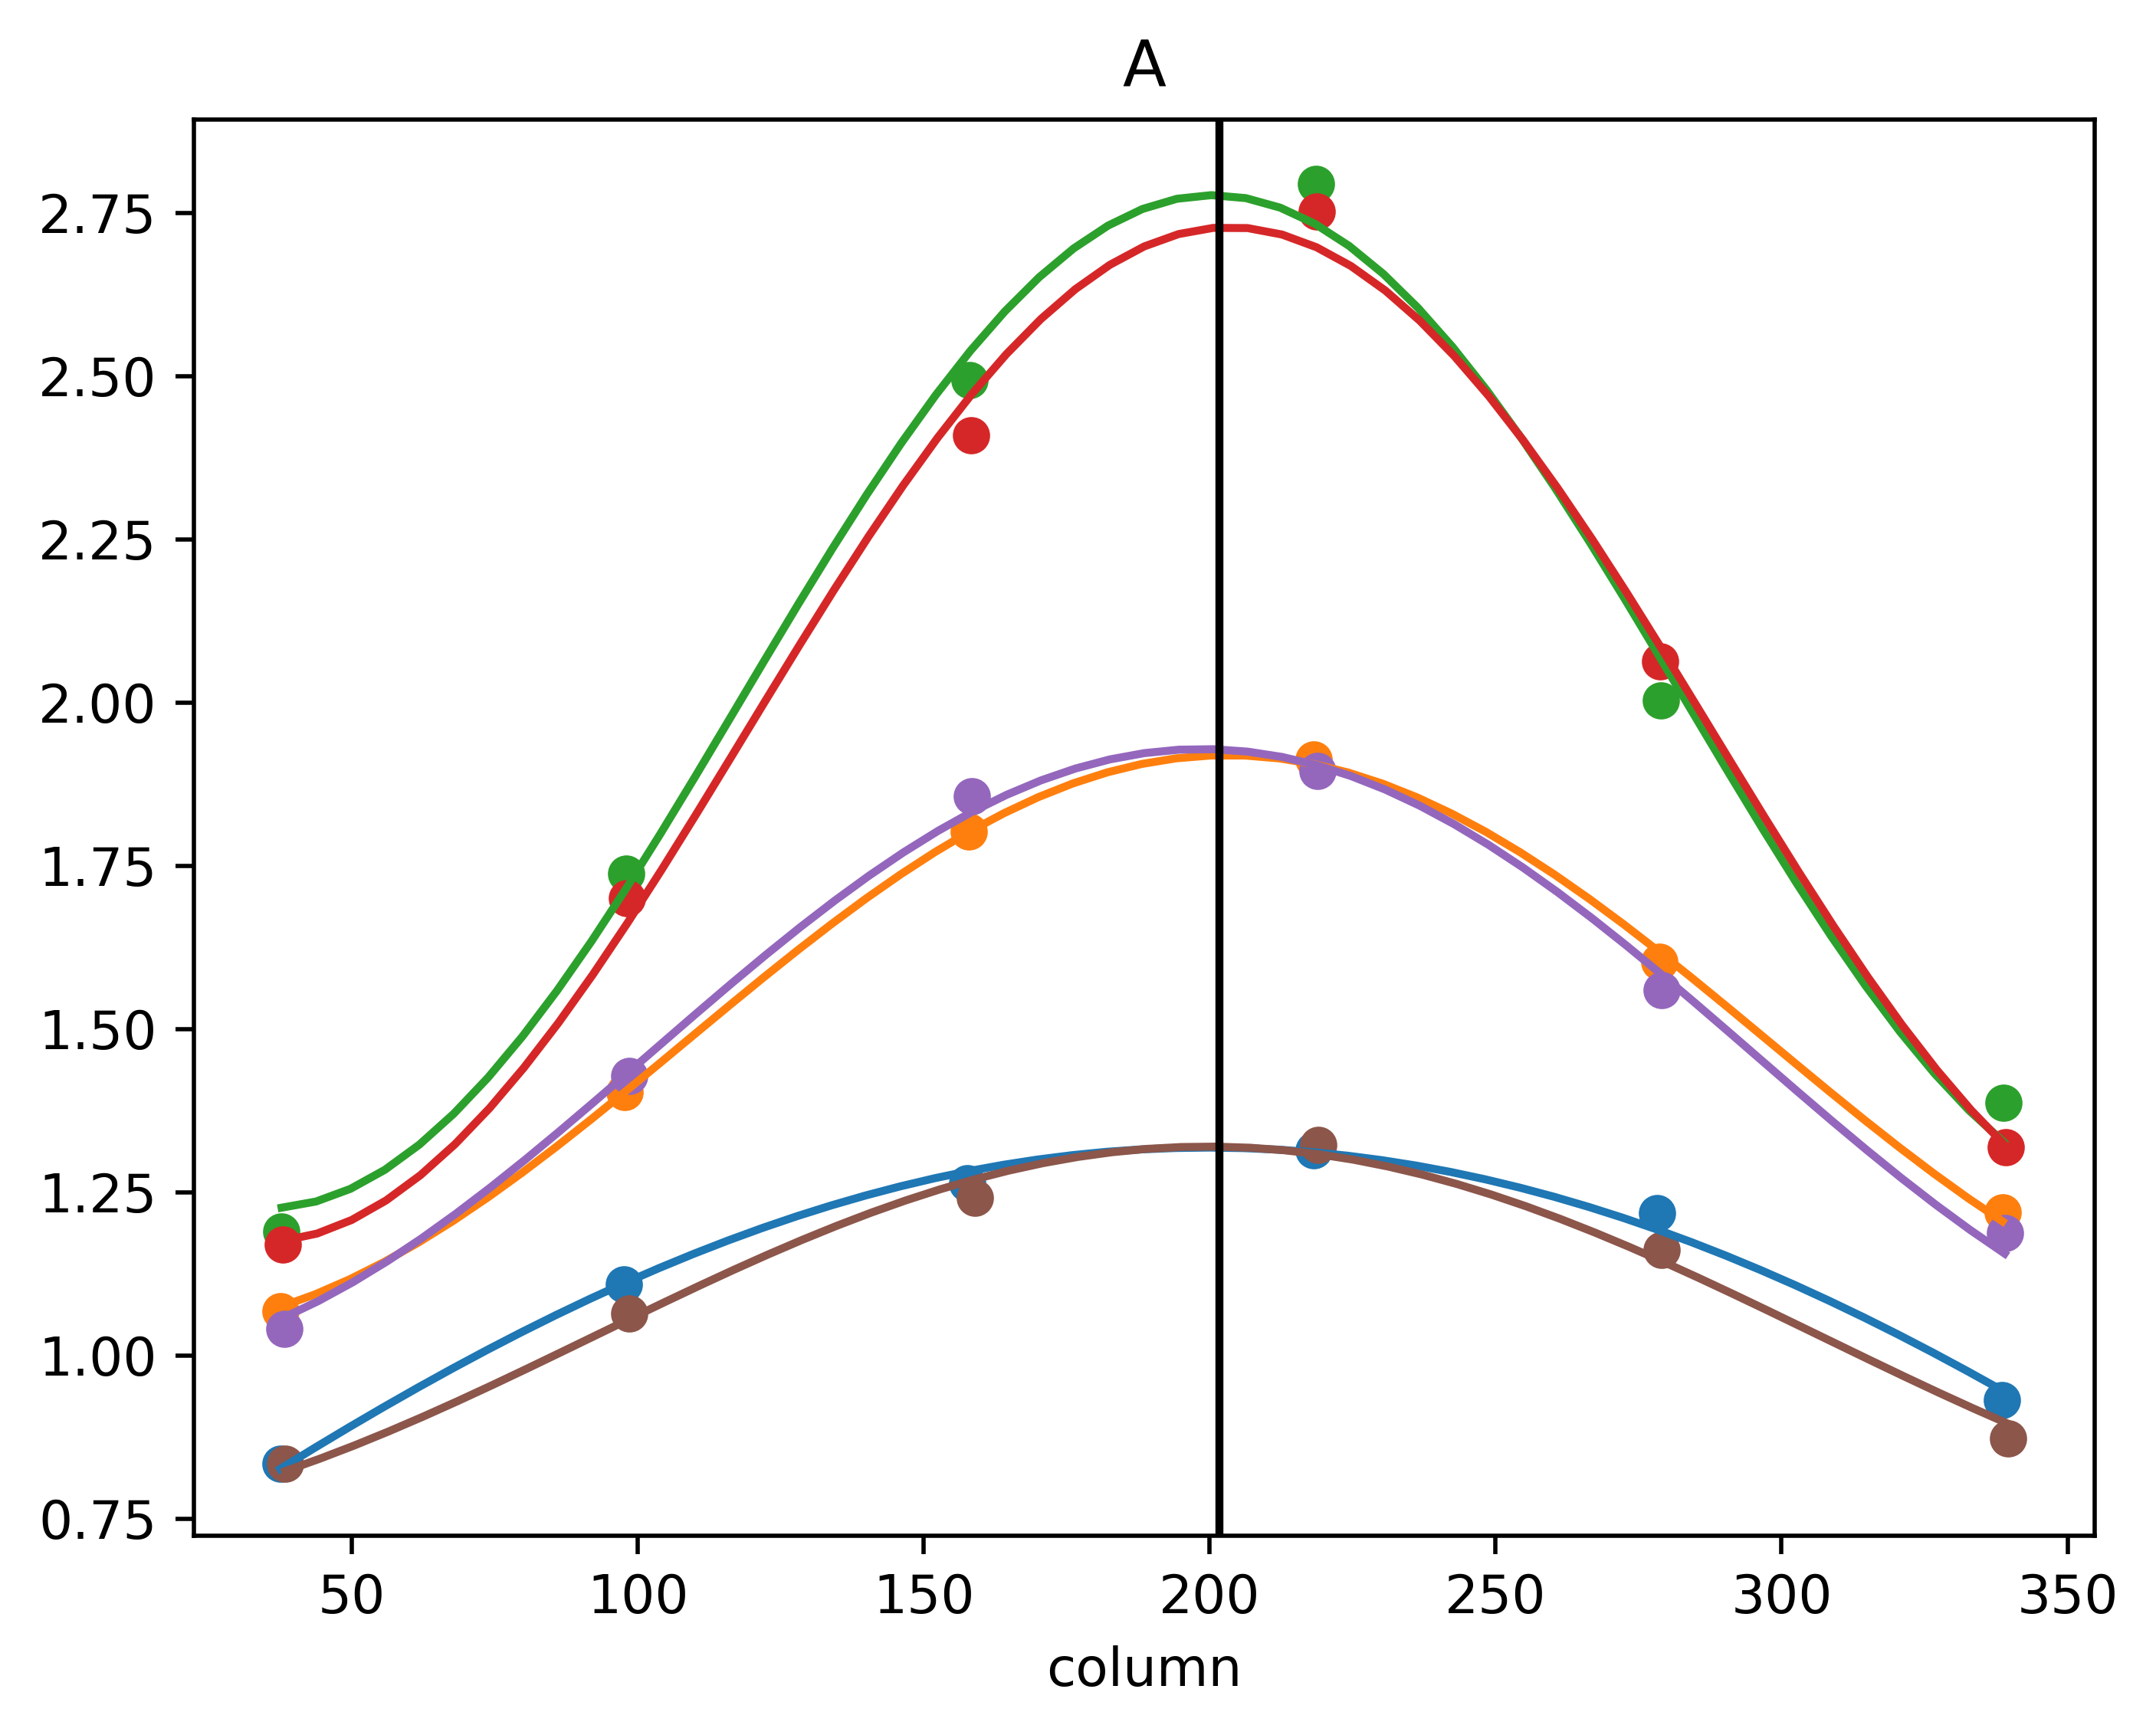
Preliminary results of mirror assembly
Joint fitting to determine row center for observations in the same column.
Joint fitting to determine column center for observations in the same row.
the central row and column of FXT-A are (187.87, 201.73).

Slide 12
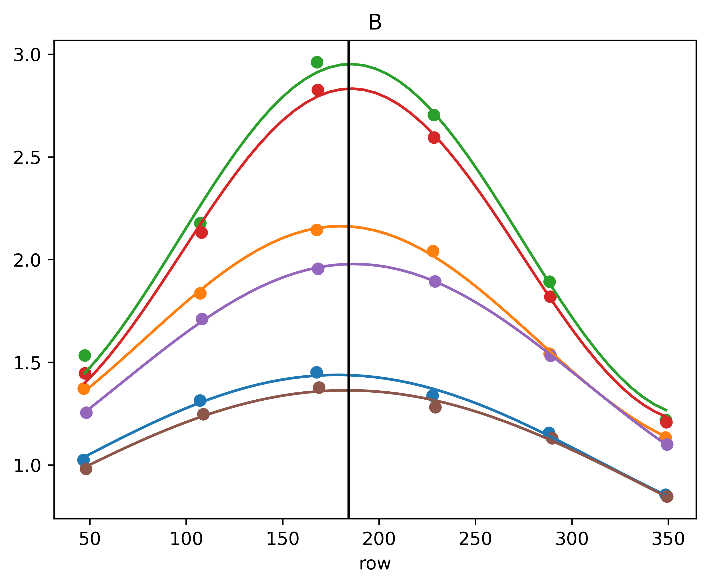
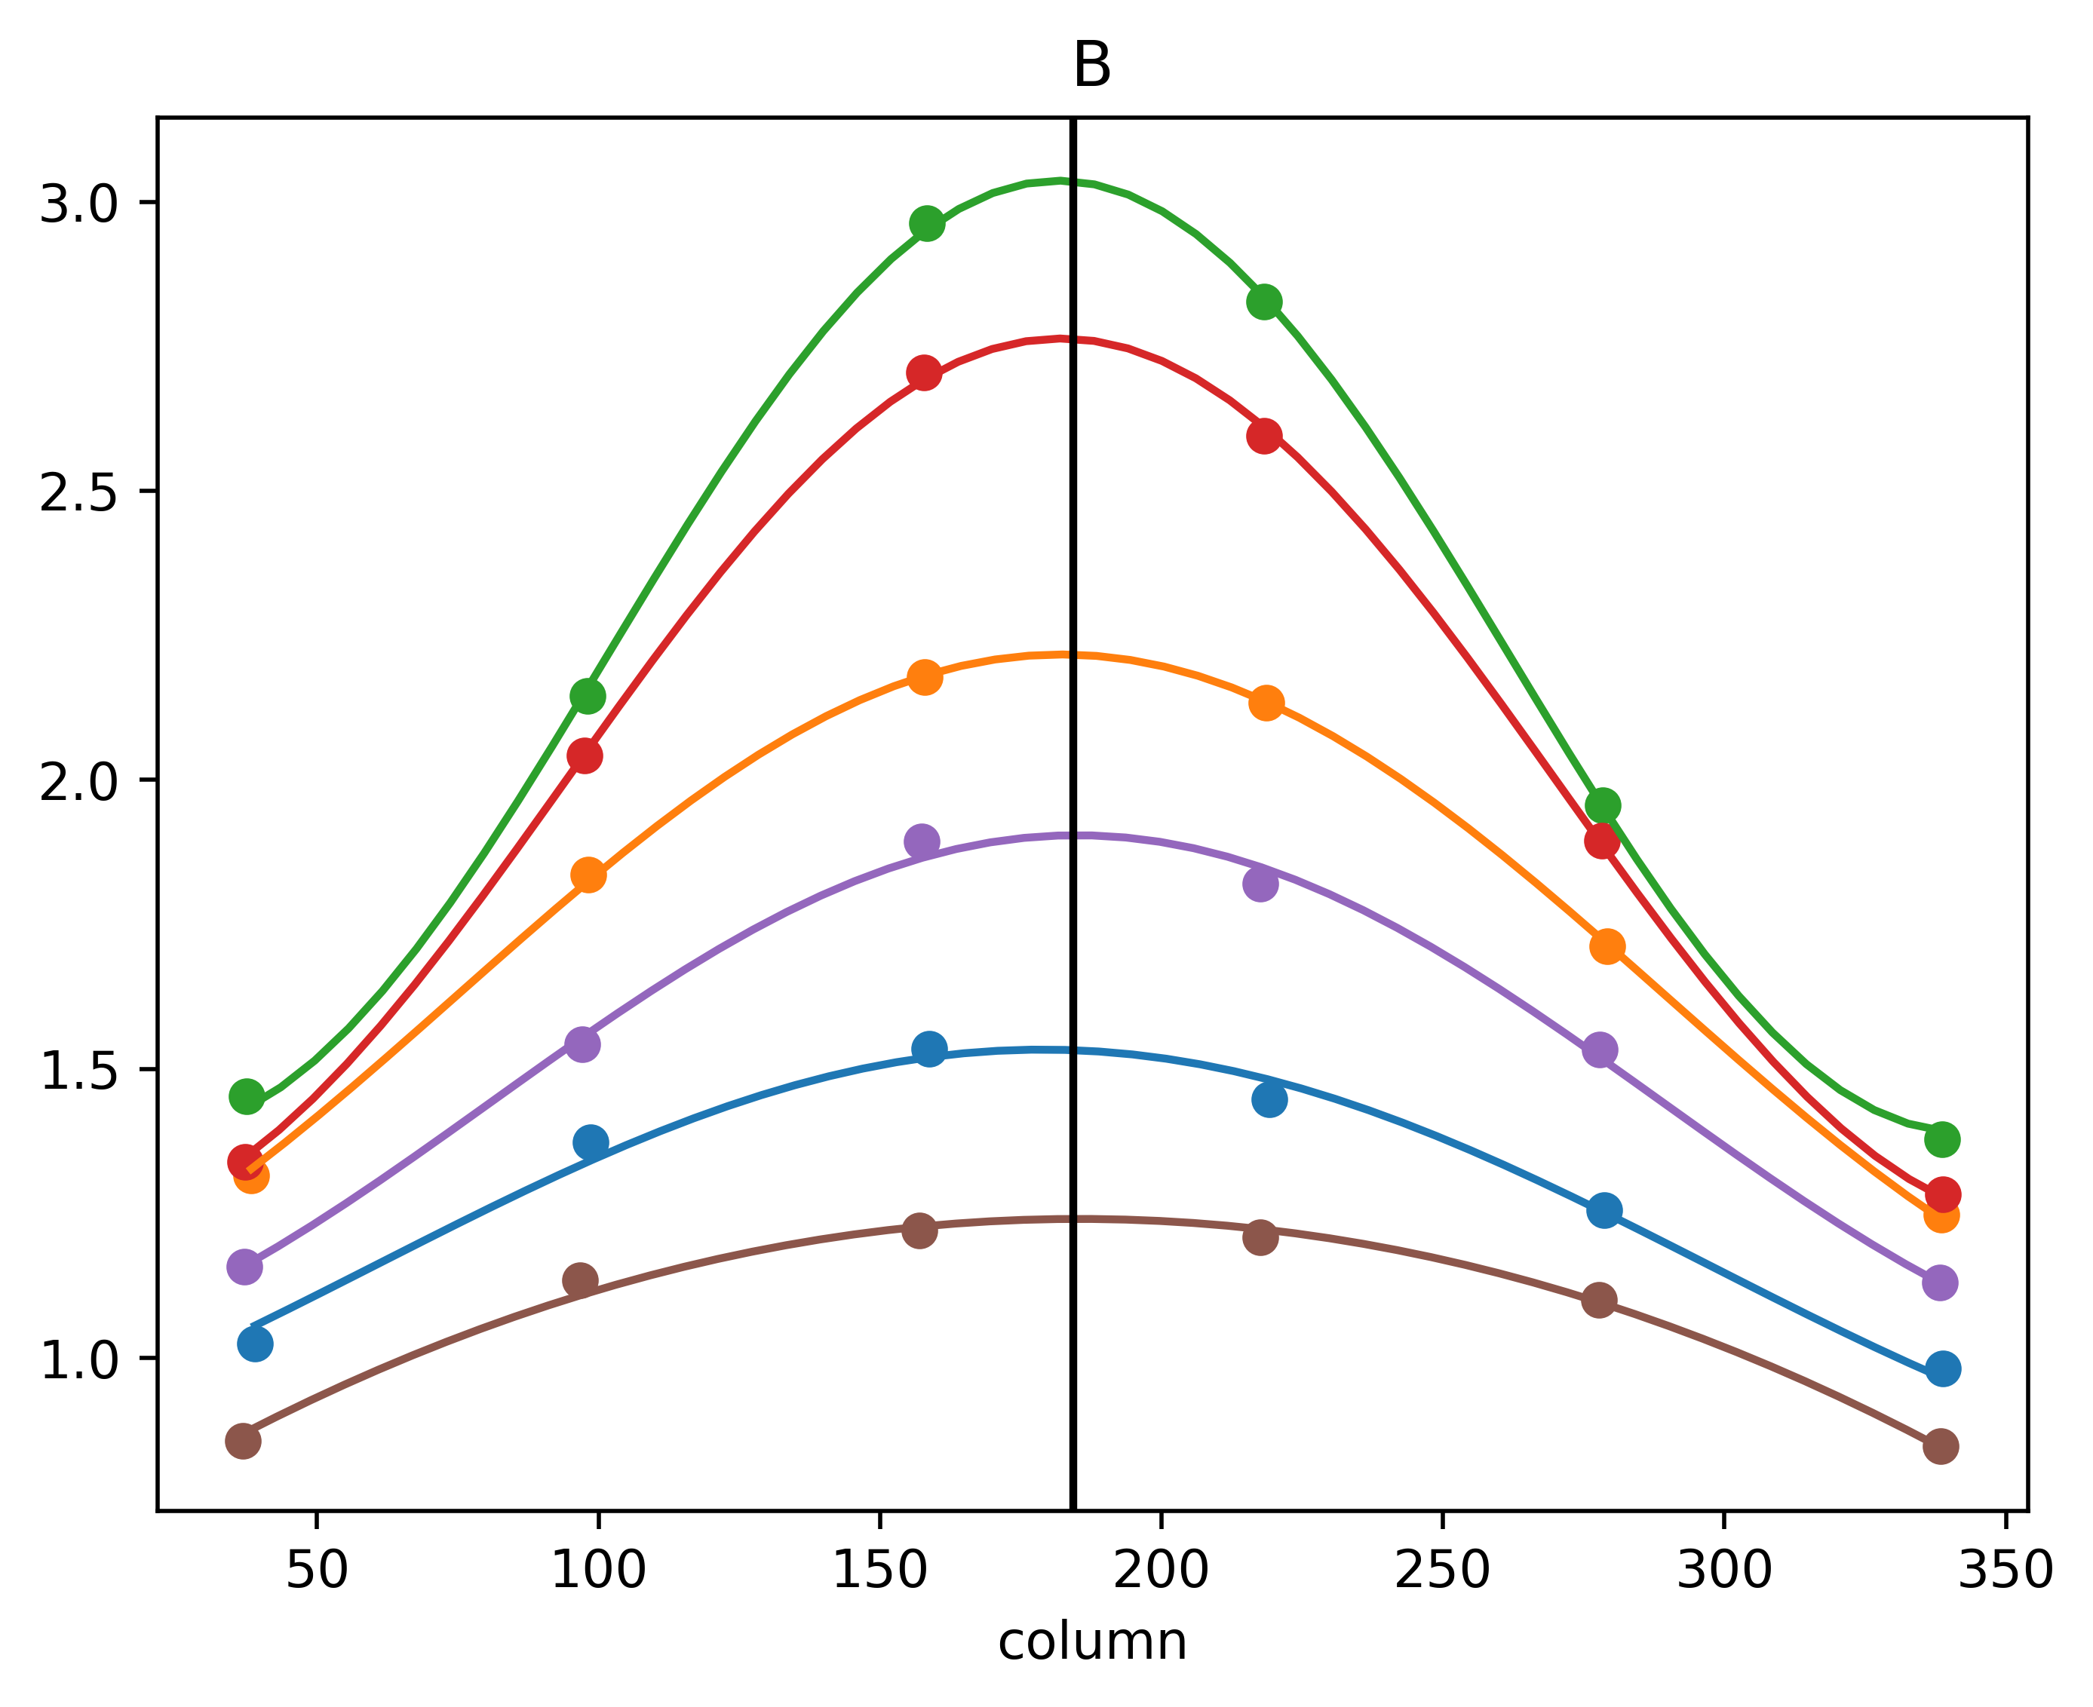
Preliminary results of mirror assembly
the central row and column of FXT-B are (184.27, 183.67).
the angle between the optical axis of FXT-A and FXT-B is 39 arcsecond.

Slide 13
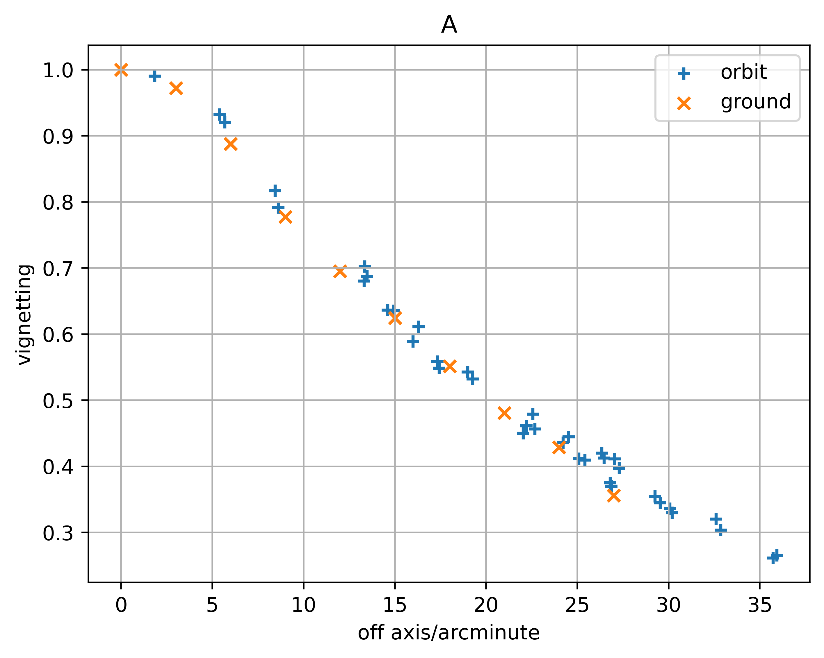
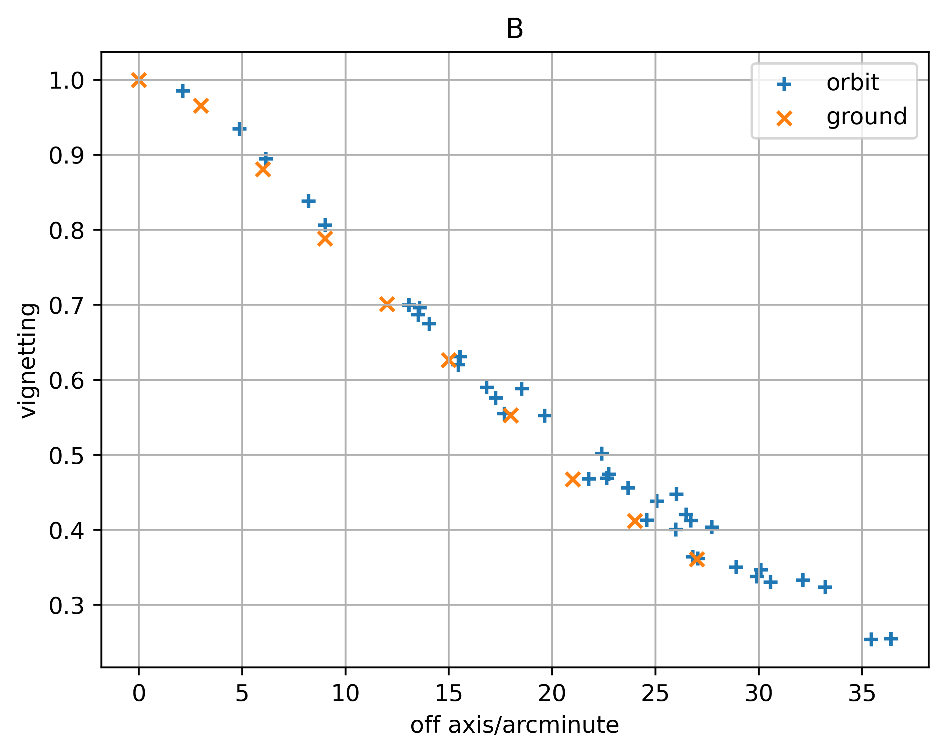
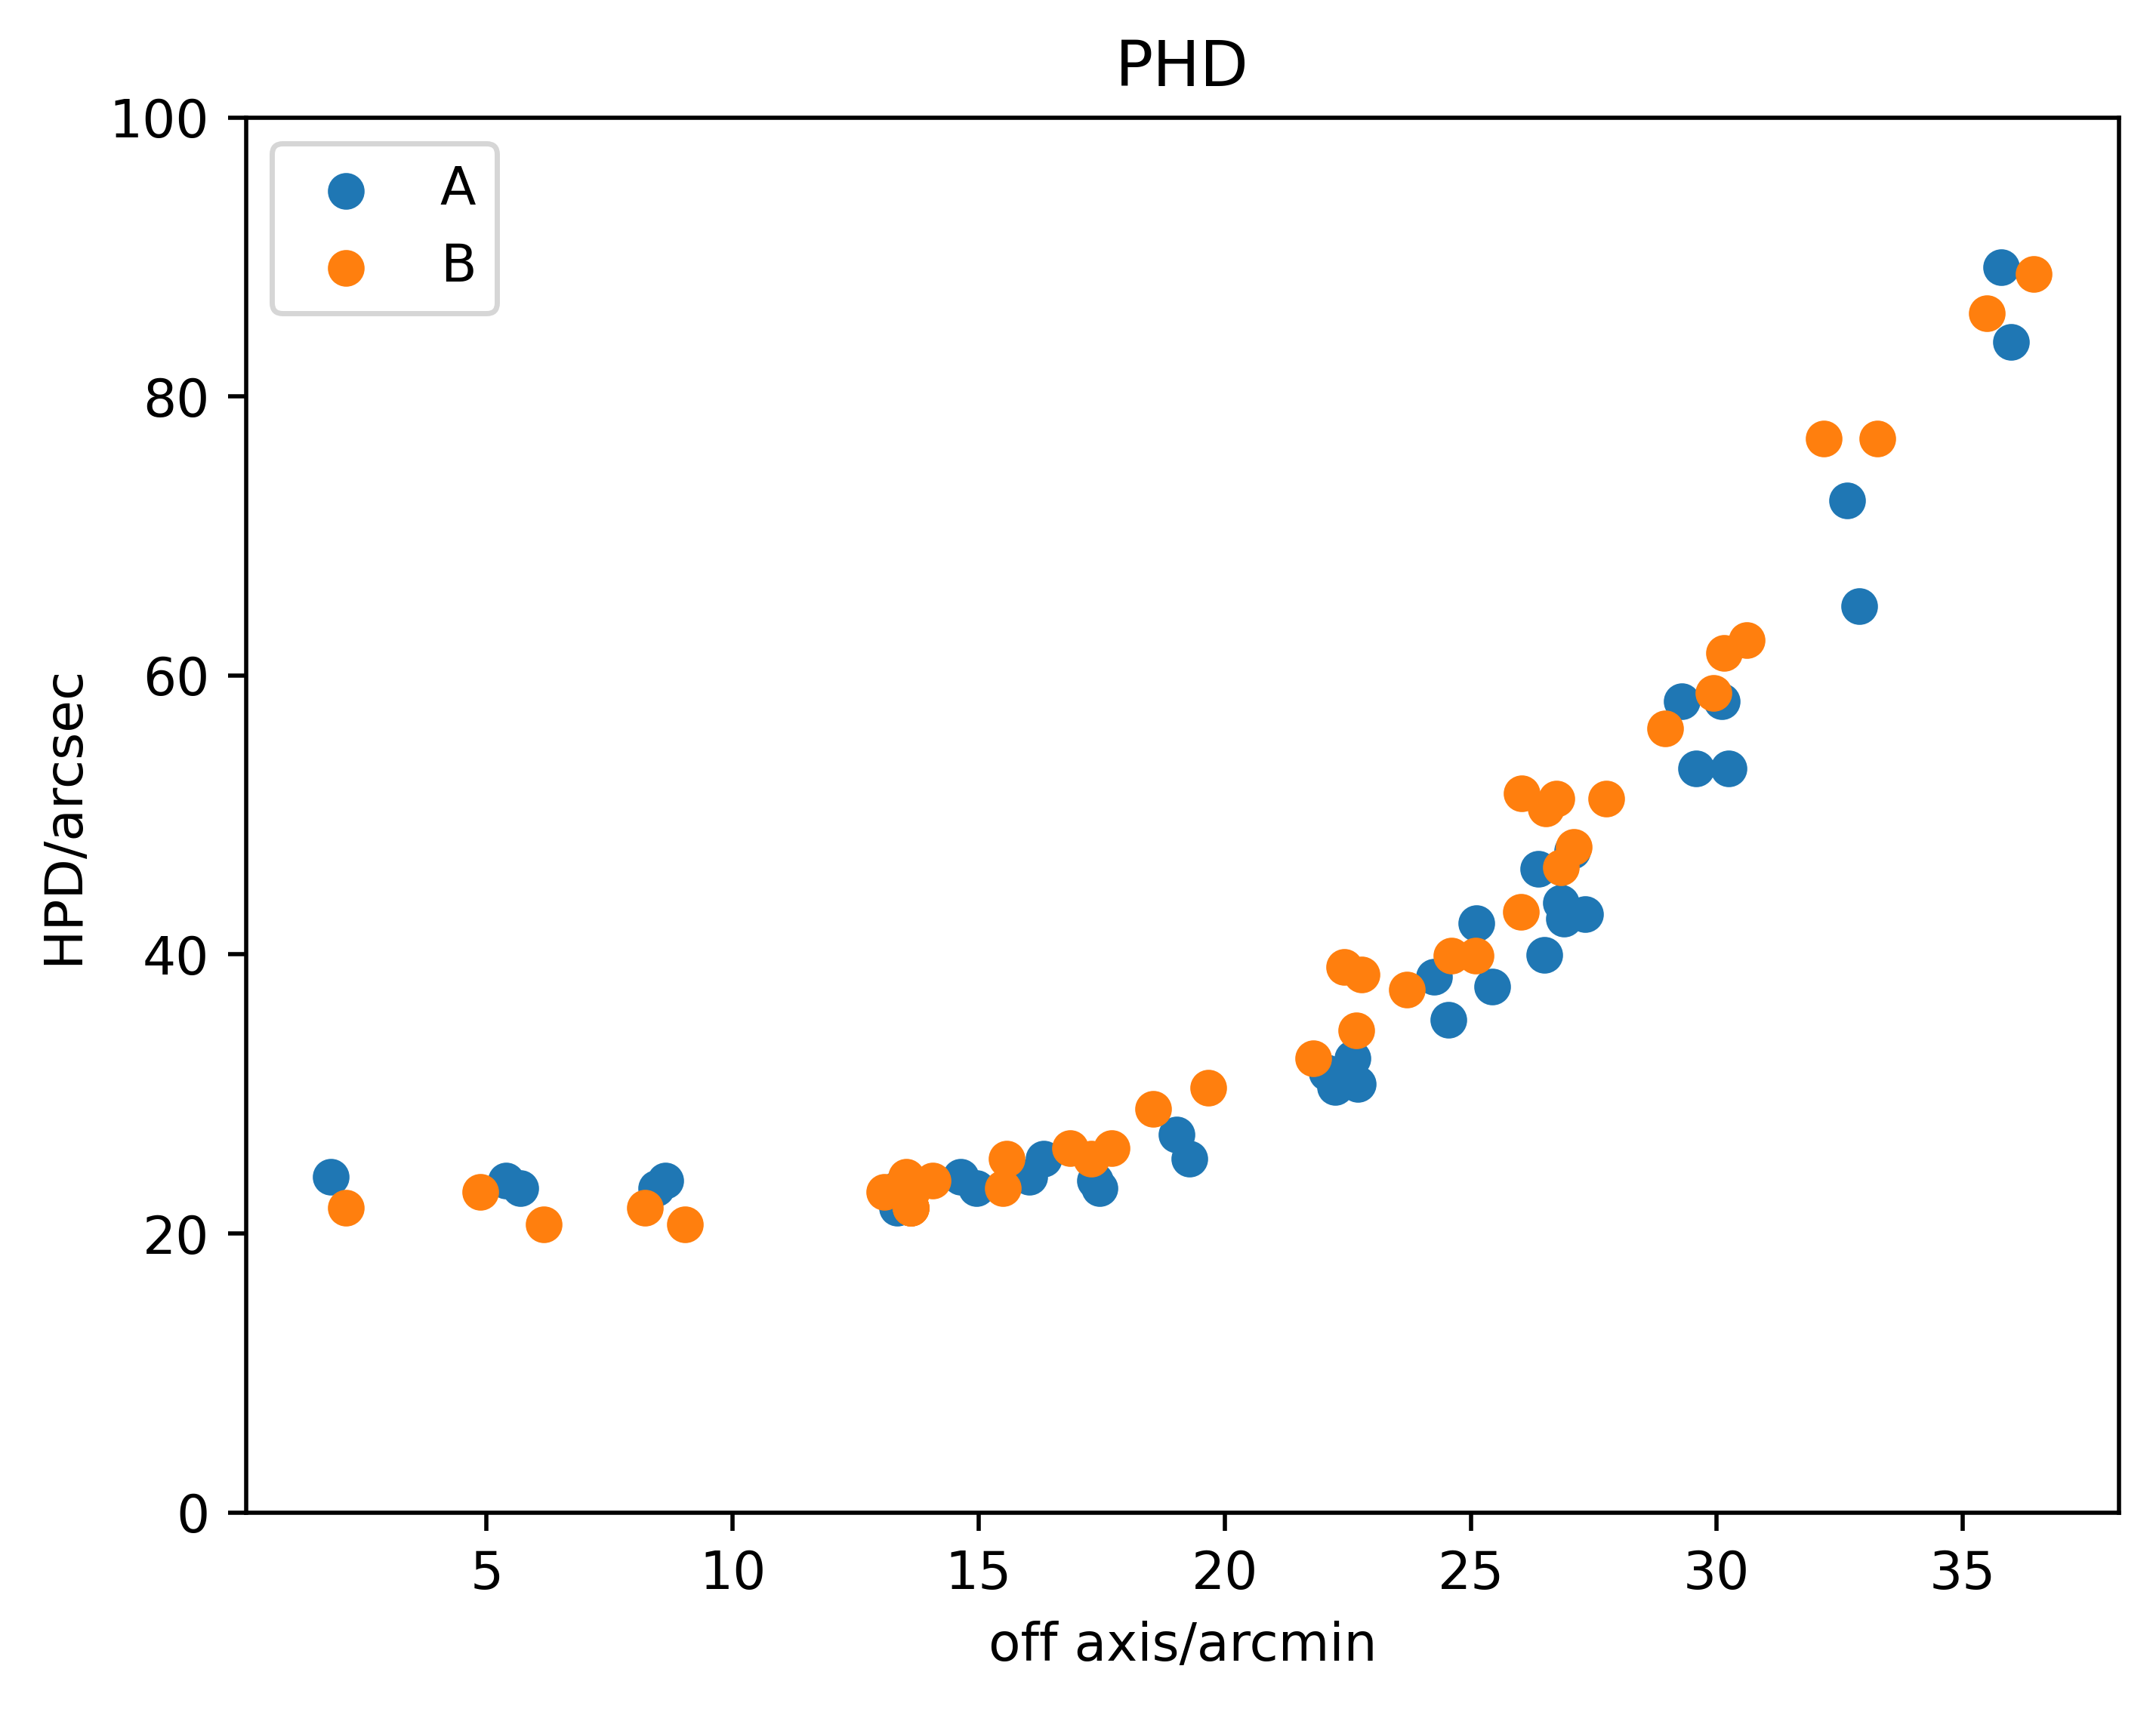
Preliminary results of mirror assembly
Using the axis scanning data, we preliminary obtained the vignetting at energy less than 4keV.The vignetting of ground and orbit are consistant.
More detailed vignettging calibration in orbit is still ongoing.
HPD of FXT-A on axis is 23.7 arcsec, and that of FXT-B is 20.1 arcsec.

Slide 14
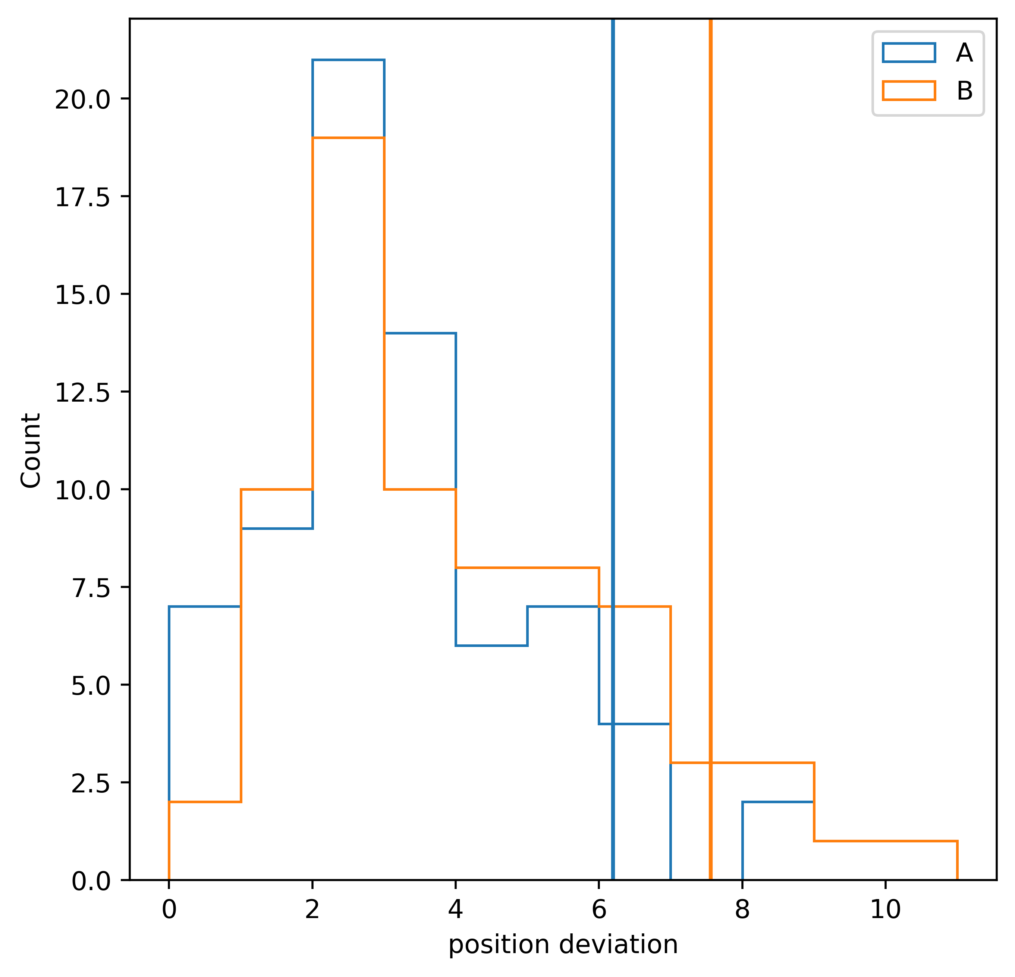
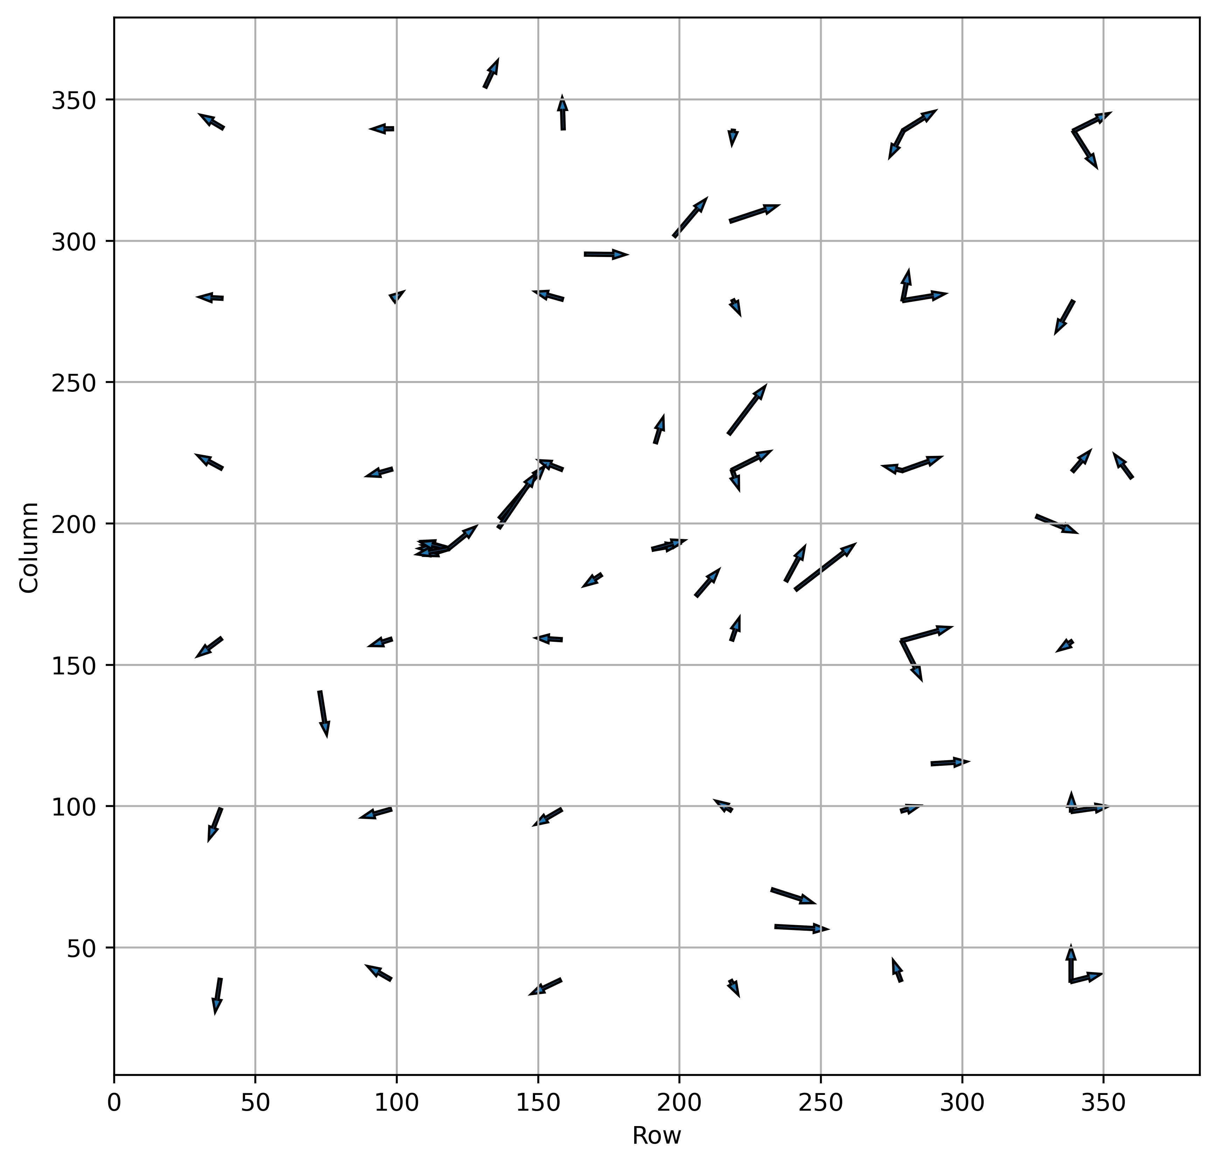
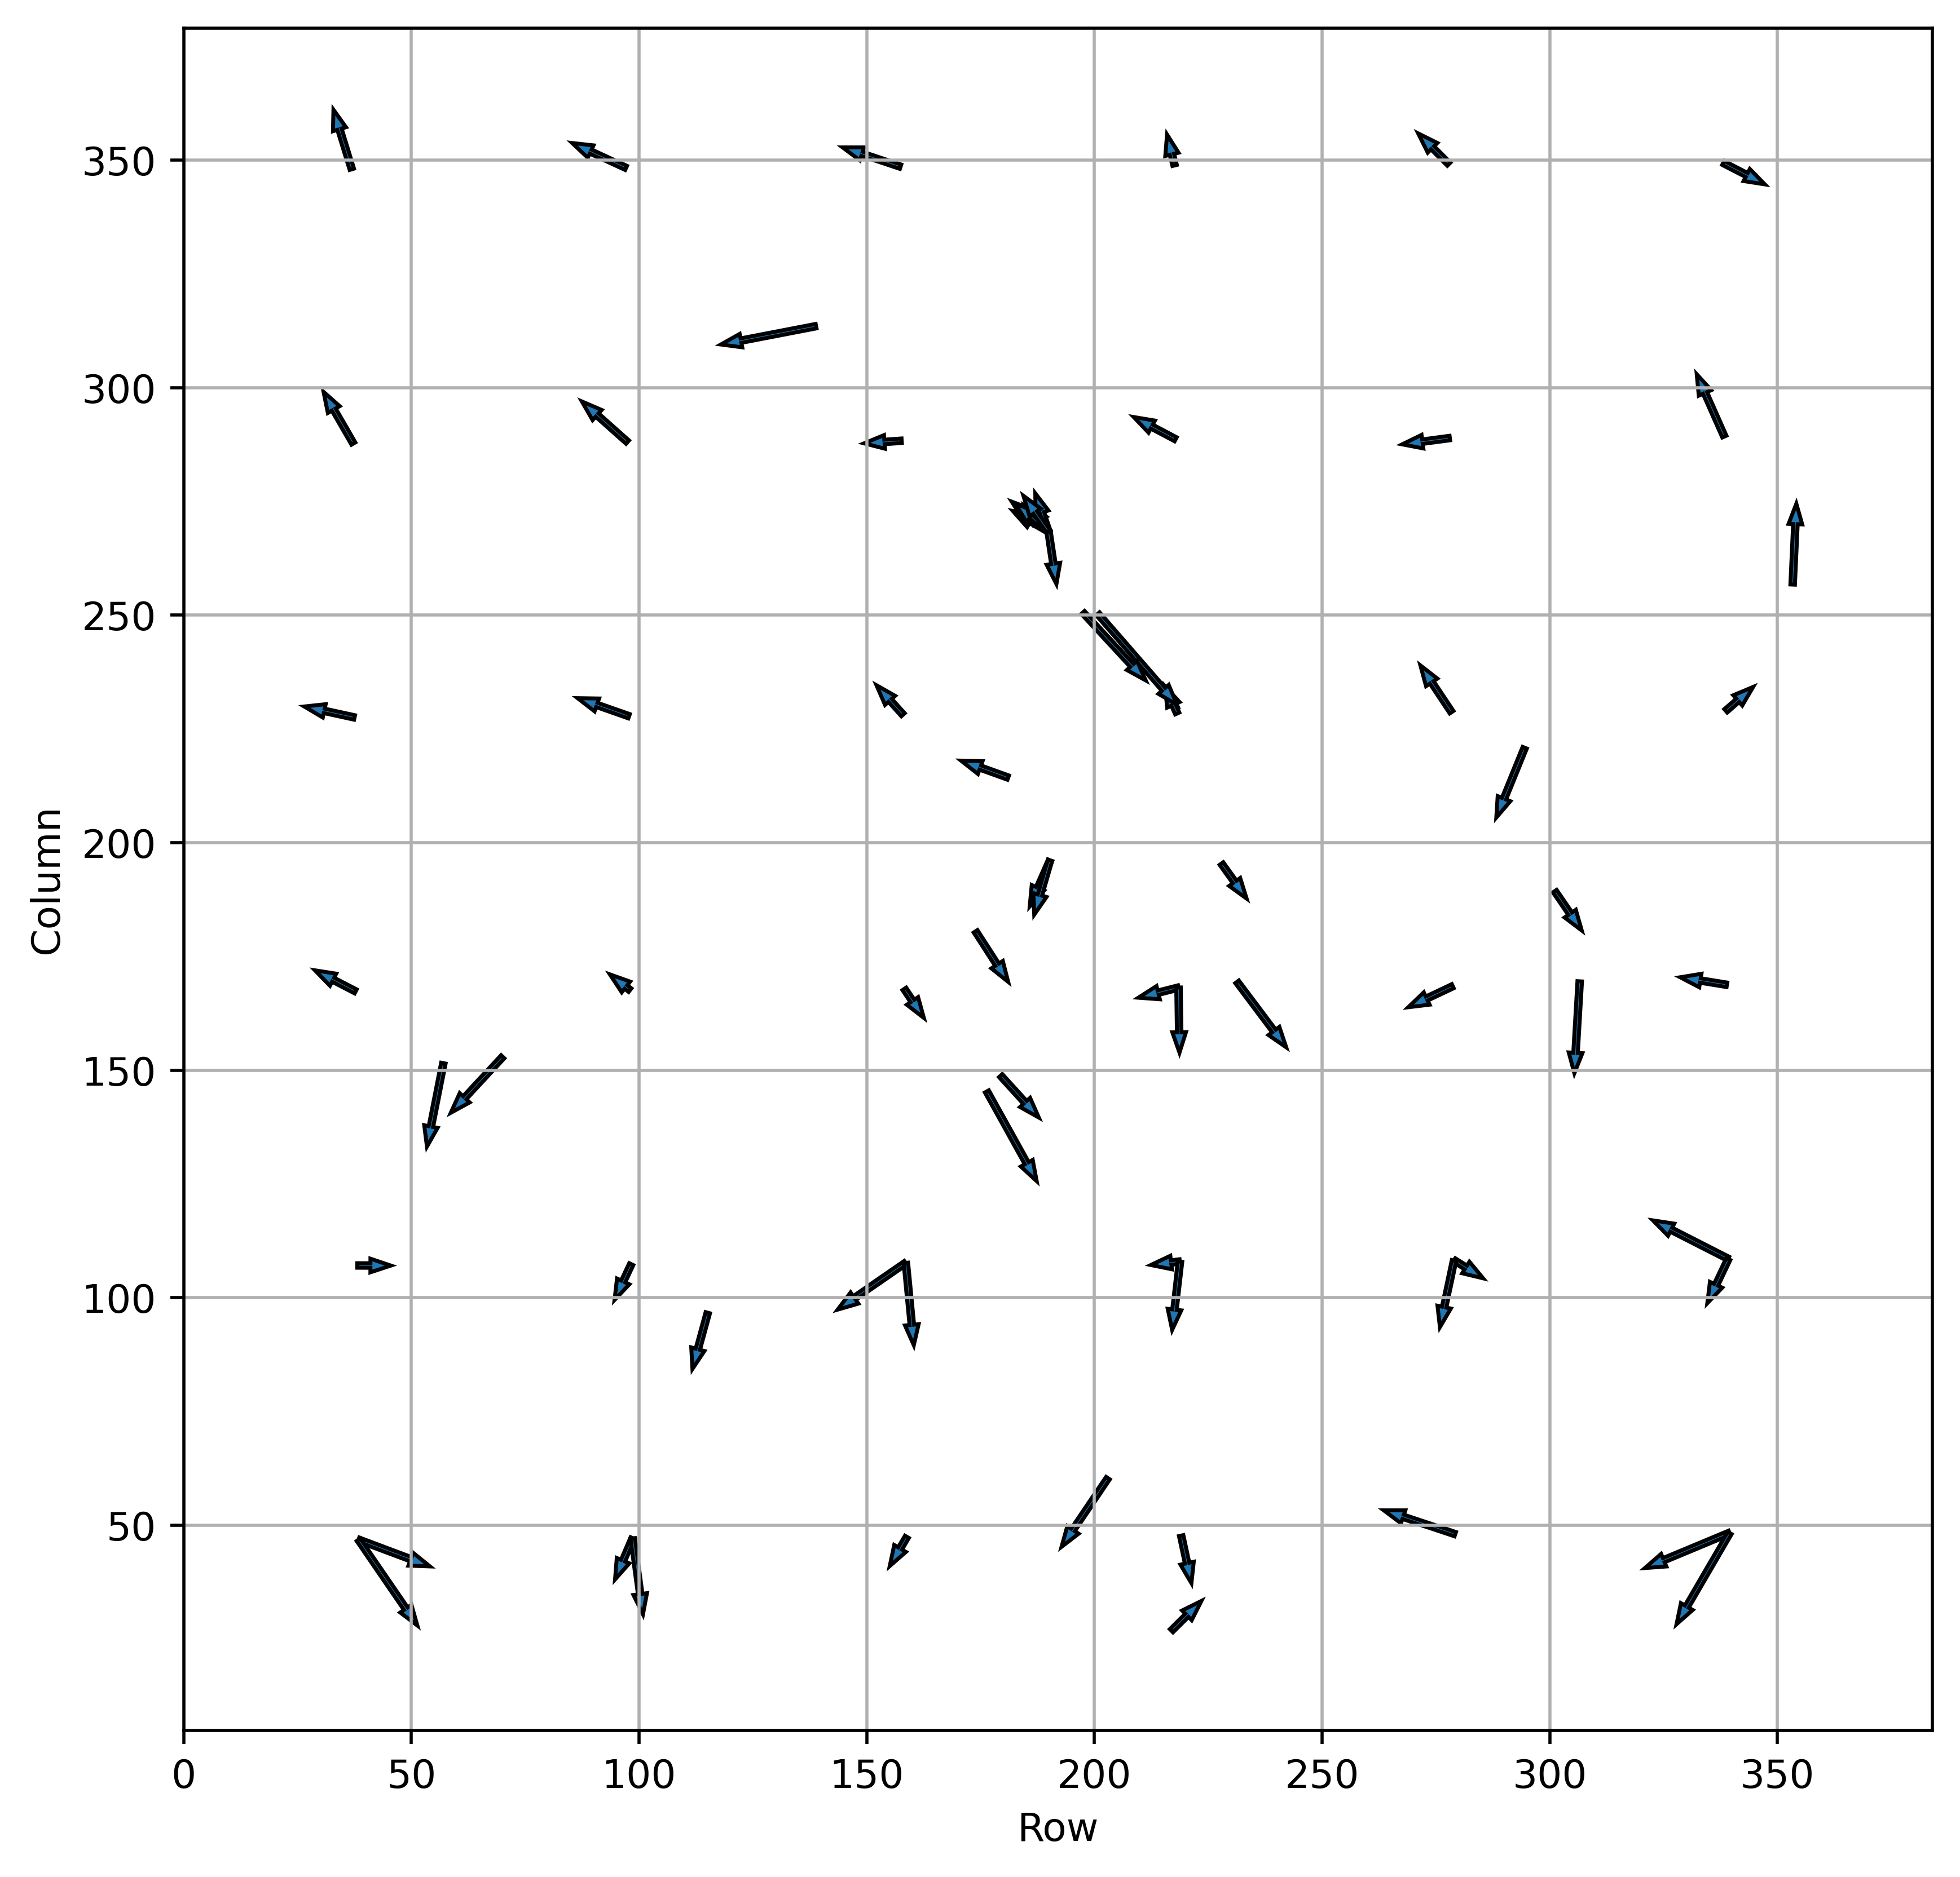
Preliminary results of mirror assembly
the position accuracy of FXT-A and FXT-B is better than 8 arcsecond (90%).
left is the distribution of position deviation of FXT-A and FXT-B.
middle and right is the distribution of deviation direction of FXT-A and FXT-B (the size of arrow has been enlarged by 20 times).

Slide 15
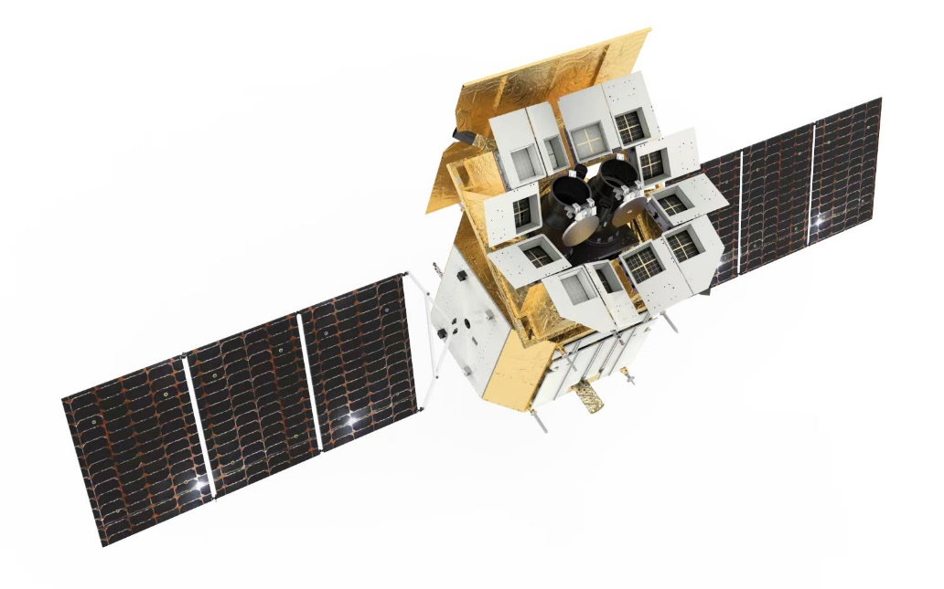
Preliminary results of mirror assembly
The current calibration observations are still being carried out intensively.
More detailed calibration results will be available in the following time.
Thanks

